Slide 1
Opening Questions
Factor each polynomial
6x² + 13x – 28 2) 5x³ – 22x + 12x – 16 *Hint, 4 is a zero
Find the zeros of each function
3) f(x) = 2x² + 3x – 2 4) f(x) = x⁴ – 9x² + 20

Slide 2
6.6: Finding Rational Zeros
Objective: Find the rational zeros of a polynomial function
Use polynomial equations to solve real-life problems

Slide 3
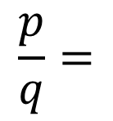
Using The Rational Zero Theorem
*Look back at opening question #2. Without the hint, this would be very difficult to factor. However, we can use the rational zero theorem to find factors
Rational Zero Theorem
If a polynomial has integer coefficients, then the rational zeros of the function are
$$\frac{p}{q}=$$
$$\frac{factor of constant term of polynomial}{factor of leading coefficient of polynomial}$$

Slide 4
Ex
Find the rational zeros of f(x) = x³ + 2x² – 11x – 12
P = factors of constant term:
Q = factors of leading coefficient:
$$\frac{±1, ±2, ±3, ±4, ±6, ±12}{±1}$$
So $\frac{p}{q}= \frac{±1}{1},\frac{±2}{1},\frac{±3}{1},\frac{±4}{1},\frac{±6}{1},\frac{±12}{1}$
1 | 2 | -11 | -12
*Test these possible zeros
1
-8
1
3
1
3
-8
-20
*Has a remainder, so 1 is not a zero

Slide 5
Ex 1 Continued
Find the rational zeros of f(x) = x³ + 2x² – 11x – 12
1 | 2 | -11 | -12
-1
12
*-1 is a zero. If you factor this term
out, you’re left with:
-1
-1
1
1
-12
0
f(x) = (x + 1)
(x² + x – 12)
*Can factor easily now
f(x) = (x+1)(x – 3)(x + 4)
Zeros of f(x) = x³ + 2x² – 11x – 12 are
x = -1, 3, -4

Slide 6
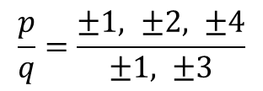
Ex 2
Find the zeros of f(x) = 3x⁴ + x³ – 8x² – 2x + 4
$$\frac{p}{q}=\frac{±1, ±2, ±4}{±1, ±3}$$
$$=±1, ±2, ±4, ±\frac{1}{3}, ±\frac{2}{3}, ±\frac{4}{3}$$
*For class purposes, we’ll be choosing the
correct zeros
-1
3 | 1 | -8 | -2 | 4
-3
2
6
-4
So far, we can rewrite the polynomial as
f(x) = (x + 1)(3x³ – 2x² – 6x + 4)
3
-2
-6
4
0
*Repeat Process

Slide 7
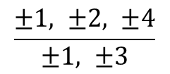
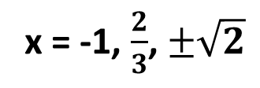
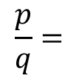
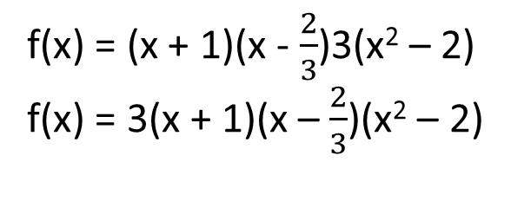
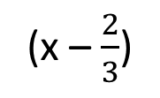
Ex 2 Continued
f(x) = (x + 1)(3x³ – 2x² – 6x + 4)
$$\frac{p}{q}=$$
$$\frac{±1, ±2, ±4}{±1, ±3}$$
$$\frac{2}{3}$$
3 | -2 | -6 | 4
2
0
-4
3
0
-6
0
*Now we have:
f(x) = (x + 1)
(x – $\frac{2}{3}$)
(3x² – 6)
Factor
f(x) = (x + 1)(x - $\frac{2}{3}$)3(x² – 2)
f(x) = 3(x + 1)(x – $\frac{2}{3}$)(x² – 2)
Therefore, the zeros of the function are:
x = -1, $\frac{2}{3}$, $±\sqrt{2}$

