Slide 1
Opening Questions
Factor
4x² – 24x 2) 2x² + 11x – 21 3) 4x² – 36x + 81
Solve
4) x² + 10x + 25 = 0 5) 6x² + x = 15

Slide 2
6.4: Factoring and Solving Polynomial Equations
Objective: Factor polynomial expressions
Use factoring to solve polynomial equations

Slide 3
Special Factoring Patterns
Sum of Two Cubes: a³ + b³ = (a + b)(a² – ab + b²)
Ex: x³ + 8
Difference of Two Cubes: a³ – b³ = (a – b)(a² + ab + b²)
Ex: 8x³ – 1
(x + 2)(x² – 2x + 4)
*Can take the cubed
root of each term
a = b =
x 2
(2x – 1)(4x² + 2x + 1)
*Can take the cubed
root of each term
a = b =
2x 1

Slide 4
Ex 3
2u²
(8u³ – 125)
2u²(2u – 5)(4u² + 10u + 25)
16u⁵ – 250u²
*Take out a
common factor
*Can take the cubed
root of each term
a = b =
2u 5

Slide 5
Now Try
x³ + 27 2) 64x³ + 1 3) 64x³ – 1
4) 3x³ – 24 5) 16x⁴ – 54x

Slide 6
Factoring By Grouping
*Most of the time, if you are given a polynomial with four terms, we can factor by grouping
Ex
x³ – 2x² – 9x + 18
x³ – 2x² + – 9x + 18
x²(x – 2) – 9(x – 2)
(x – 2)(x² – 9)
(x – 2)(x – 3)(x + 3)
*Group first two/last two terms
( ) ( )
*Factor each group
*They both have a common factor of x – 2, factor that out
*The last term is the difference of two squares, factor that

Slide 7
Ex 2
x³ + x² – 4x – 4
x³ + x² + – 4x – 4
x²(x + 1) – 4(x + 1)
(x + 1)(x² – 4)
(x + 1)(x – 2)(x + 2)
( ) ( )

Slide 8
Now Try
x³ – x² – 9x + 9 2) x³ – x + 9x² – 5
3) x³ – 3x² – 16x + 48

Slide 9
More Factoring
Ex
81x⁴ – 16
*Meets requirements
for difference of two
squares
(9x² + 4)(9x² – 4)
(9x² + 4)(3x + 2)(3x – 2)
*Meets requirements
for difference of two
squares

Slide 10
Ex 2
x⁴ + 6x² + 9
(x² + 3)(x² + 3)
(x² + 3)²

Slide 11
Now Try
25x⁴ – 9 2) x⁴ + x² – 6 3) x⁴ – 16x² + 64
4) 49x⁴ – 4 5) 4x⁶ – 20x⁴ + 24x²

Slide 12

Solving Polynomial Equations by Factoring
Ex Solve 2x⁵ + 24x = 14x³
2x⁵ – 14x³ + 24x = 0
2x(x⁴ – 7x² + 12) = 0
2x(x² – 3)(x² – 4) = 0
2x(x² – 3)(x + 2)(x – 2)
*Set equation equal to zero
*Factor out 2x
*Factor trinomial
*Continue Factoring
*Set each multiple equal to zero
2x = 0
x = 0
x² – 3 = 0
x² = 3
x = $±\sqrt{3}$
x + 2 = 0
x = -2
x – 2 = 0
x = 2

Slide 13
Ex 2
3x² + 21x = 24x²
3x³ – 24x² + 21x = 0
3x(x² – 8x + 7) = 0
3x(x – 7)(x – 1) = 0
3x = 0 x – 7 = 0 x – 1 = 0
x = 0
x = 7
x = 1

Slide 14
Now Try
Find the real-number solutions of the equation
3x² = 9x 2) x² = 2x + 15 3) 4x³ = 16x
4) x² + 2x = 24

Slide 15
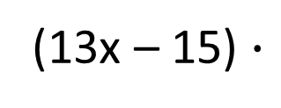
Real World Application
In 1980, archeologists at the ruins of Caesara discovered a huge hydraulic concrete block with a volume of 330 cubic yards. The block’s dimensions are x yards high by 13x – 11 yards long by 13x – 15 yards wide. What is the height?
Volume = Length $∙$ Width $∙$ Height
330
= (13x – 11) $∙$
(13x – 15) $∙$
x
*Foil out
330 = (169x² – 195x
– 143x + 165) $∙$ x
*Combine like terms

Slide 16
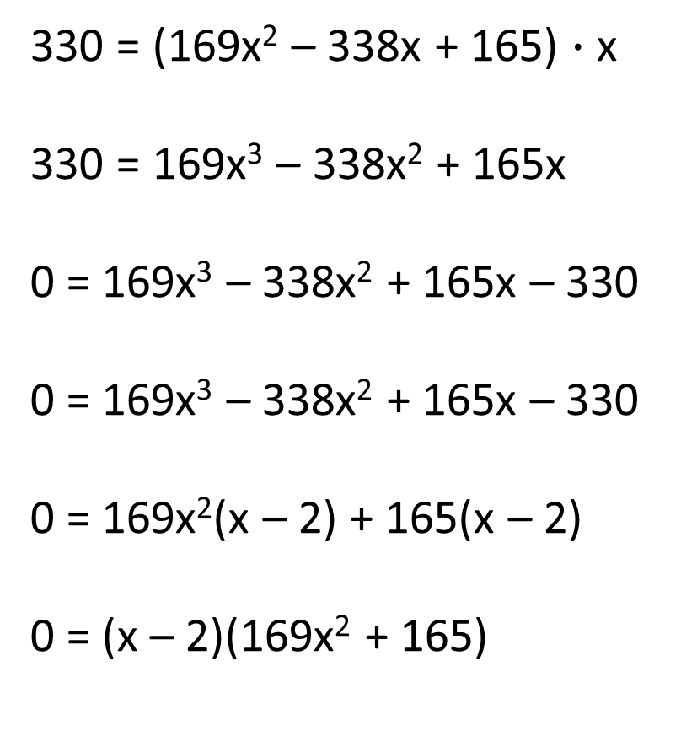
Real World Application Continued
330 = (169x² – 338x + 165) $∙$ x
330 = 169x³ – 338x² + 165x
0 = 169x³ – 338x² + 165x – 330
0 = 169x³ – 338x² + 165x – 330
0 = 169x²(x – 2) + 165(x – 2)
0 = (x – 2)(169x² + 165)
*Multiply the x through
*Set equation equal to zero
*Factor by grouping
( ) ( )
*Set each multiple equal to zero

Slide 17
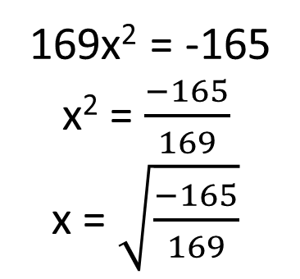
Real World Application Continued
x – 2 = 0 169x² + 165 = 0
x = 2
169x² = -165
x² = $\frac{−165}{169}$
x = $\sqrt{\frac{−165}{169}}$
*Taking the square root of a negative
number results in an imaginary number,
so this is not a possible answer
The height of the concrete block is 2 yards

Slide 18
Now Try
An optical company is going to make a glass prism that has a volume of 15cm³. The height will be h cm and the base will be a right triangle with legs of length (h – 2) and (h – 3). What will be the height?

