Slide 1
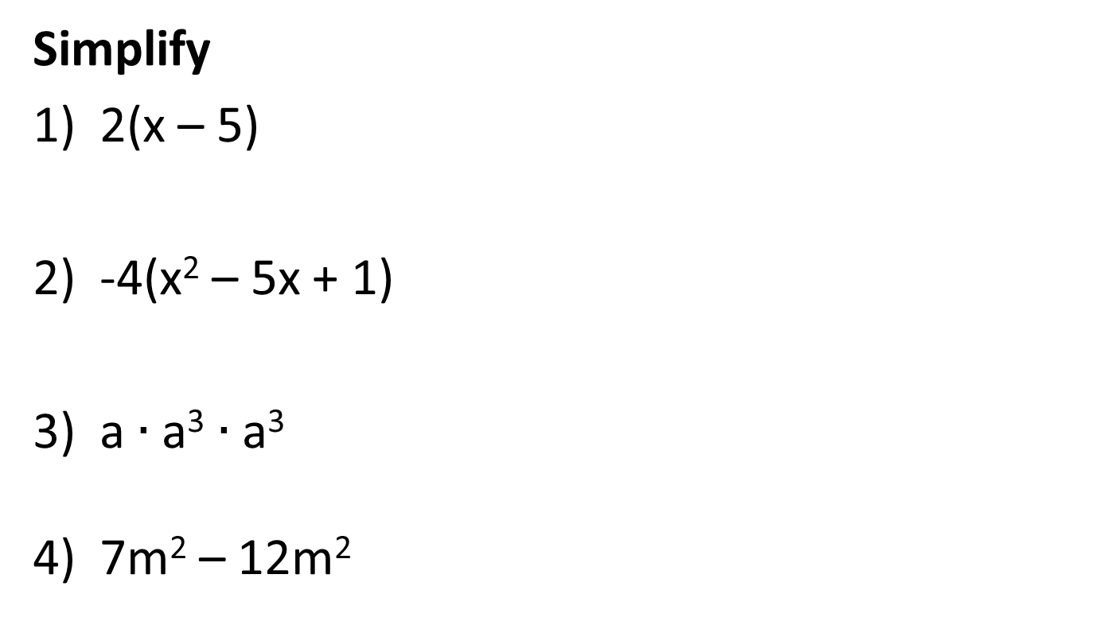
Opening Questions
Simplify
2(x – 5)
-4(x² – 5x + 1)
a $∙$ a³ $∙$ a³
7m² – 12m²

Slide 2
6.3: Adding, Subtracting, and Multiplying Polynomials
Objective: Add, subtract, and
multiply polynomials

Slide 3
Adding Polynomials
*Only add terms with the same variable raised to the same exponent
Ex
(3x³ + 2x² – x – 7) + (x³ – 10x + 8)
3x³ + 2x² – x – 7
+ x³ – 10x + 8
4x³ + 2x² – 11x + 1
*Either set up
vertically or add
horizontally

Slide 4
Subtracting Polynomials
*Only subtract terms with the same variable raised to the same exponent
*Make sure to distribute the negative to each term
(8x³ – 3x² – 2x + 9) – (2x³ + 6x² – x + 1)
8x³ – 3x² – 2x + 9
2x³ + 6x² – x + 1
6x³ – 9x² – x + 8
– ( )

Slide 5
Now Try
(5x² + 2x + 1) + (4x² + 3x – 8)
(5x² – 6x – 1) – (4x² – 2x + 1)
(14 – 6x) + (8x – 5)
(x² – 2x + 7) – (-5x² – 3)

Slide 6
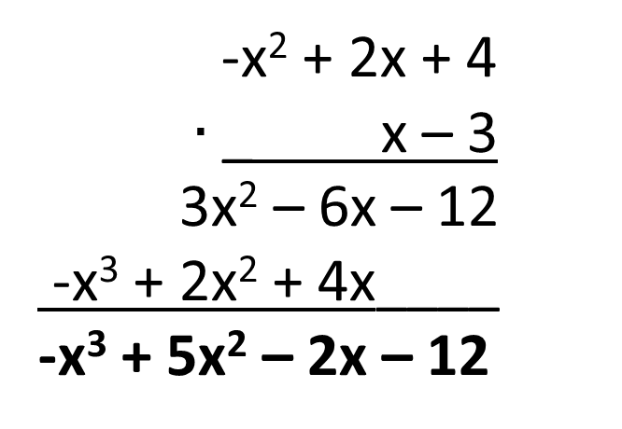
Multiplying Polynomials
Vertically: (-x² + 2x + 4)(x – 3)
-x² + 2x + 4
$∙$ _ x – 3
3x² – 6x – 12
-x³ + 2x² + 4x____
-x³ + 5x² – 2x – 12

Slide 7
Horizontally:
*Make sure every term has
been multiplied
*It’s easier if the first
polynomial has less terms
Ex
(3x² – 2x – 4)(x – 3)
(x – 3)(3x² – 2x – 4)
3x³ – 2x² – 4x
– 9x² + 6x + 12
3x³ – 11x² + 2x + 12

Slide 8
Multiplying Three Binomials
Ex
(x – 1)(x + 4)(x + 3)
= (x – 1)(x² + 7x + 12)
= x³ + 7x² + 12x
– x² – 7x – 12
= x³ + 6x² + 5x – 12

Slide 9
Ex 2
(2x + 3y)³
(2x + 3y)(2x + 3y)(2x + 3y)
= (2x + 3y)(4x² + 6xy
+ 6xy+ 9y²)
= (2x + 3y)(4x² + 12xy + 9y²)
= 8x³ + 24x²y + 18xy²
+ 12x²y + 36xy² + 27y³
= 8x³ + 36x²y + 54xy² + 27y³

Slide 10
Now Try
3x(x² + x – 2) 2) (2x + 1)(x² – x – 3)
3) (9y – x²)² 4) (ab + 2)³

Slide 11
Real World Application
From 1985 – 1995, the gross farm income G and farm expenses E (in billions of dollars) in the U.S. can be modeled by
G = -.246t² + 7.88t + 159
E = .174t² + 2.54t + 131
where t is the number of years since 1985. Write a model for net farm income N for those years.

Slide 12
Real World Application Continued
*To find net income, subtract expenses, E, from income, G.
-.246t² + 7.88t + 159
.174t² + 2.54t + 131
– ( )
N = -.420t² + 5.34t + 28

Slide 13
Now Try:
From 1982 – 1995, the number of softbound books N (in millions) sold in the U.S. and the average price per book P (in dollars) can be modeled by
N = 1.36t² + 2.53t + 1076
P = .314t + 3.42
where t is the number of years since 1982.
Write a model for the total revenue R received from the sales of softbound books.
What was the total revenue from softbound books in 1990?

