Slide 1
Opening Questions
Identify each function as linear or quadratic
f(x) = 2x² + x – 6
f(x) = 5x + 3
Find f(x) when x = -2
f(x) = 2x – 9
f(x) = x² – 5x + 7
f(x) = 3x³ + 10

Slide 2
6.2: Evaluating and Graphing Polynomial Functions
Objective: Evaluate a polynomial function
Graph a polynomial function

Slide 3
Vocab
Polynomial Function – the form
$$f\left(x\right)=a_{n}x^{n}+a_{n−1}x^{n−1}+..+a_{1}x+a_{0}$$
*In a polynomial function, you want your largest exponent on the left and decrease from left to right
ex: $f(x)=\frac{1}{2}x^{2}−{3x}^{4}−7$
Leading Coefficient - $a_{n}$, or the coefficient in front of the variable with the largest exponent
Constant Term - $a_{0}$, or the number with no variable
Degree - $n$, or the largest exponent
$$f\left(x\right)=−{3x}^{4}+\frac{1}{2}x^{2}−7$$

Slide 4
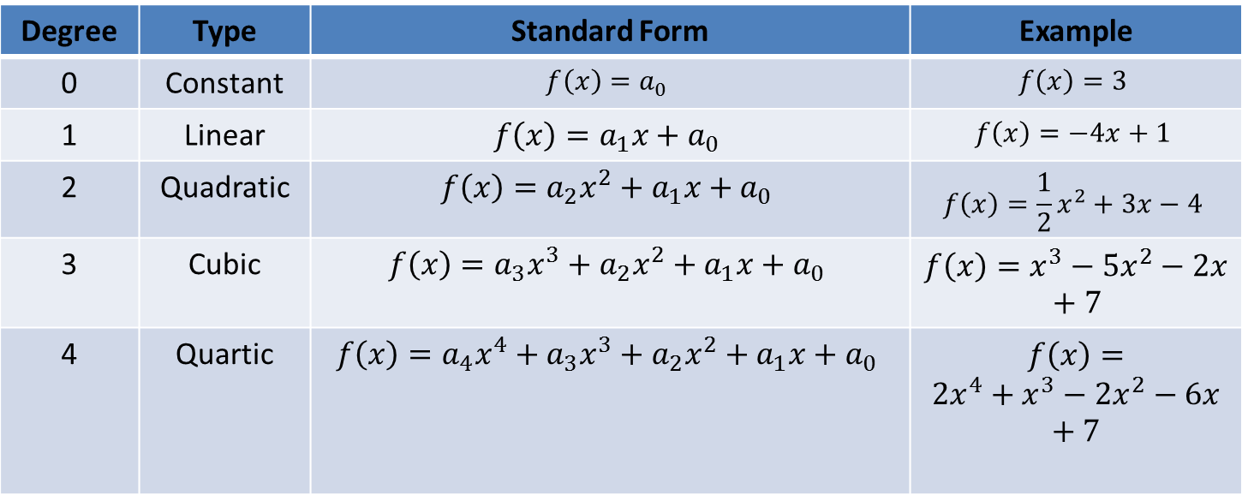
Types of Polynomial Functions
Degree | Type | Standard Form | Example
0 | Constant | $$f\left(x\right)=a_{0}$$ | $$f\left(x\right)=3$$
1 | Linear | $$f\left(x\right)={a_{1}x+a}_{0}$$ | $$f\left(x\right)=−4x+1$$
2 | Quadratic | $$f\left(x\right)={{a_{2}x_{}^{2}+a}_{1}x+a}_{0}$$ | $$f\left(x\right)=\frac{1}{2}x^{2}+3x−4$$
3 | Cubic | $$f\left(x\right)={a_{3}x_{}^{3}+{a_{2}x_{}^{2}+a}_{1}x+a}_{0}$$ | $$f\left(x\right)=x^{3}−5x^{2}−2x+7$$
4 | Quartic | $$f\left(x\right)={a_{4}x_{}^{4}+a_{3}x_{}^{3}+{a_{2}x_{}^{2}+a}_{1}x+a}_{0}$$ | $$f\left(x\right)=$$ $${2x}^{4}+x^{3}−2x^{2}−6x+7$$

Slide 5
Identifying Parts of a Polynomial Function
Ex 1:
f(x) = x + 5x³
Standard Form:
Leading Coefficient:
Degree:
Constant Term:
Type of Polynomial:
f(x) = 5x³ + x
5
3
0
Cubic

Slide 6
Ex 1:
f(x) = x³+ 3^{x}
Standard Form:
Leading Coefficient:
Degree:
Constant Term:
Type of Polynomial:
Not a polynomial function.
The function has an exponent
that isn’t a positive whole
number

Slide 7
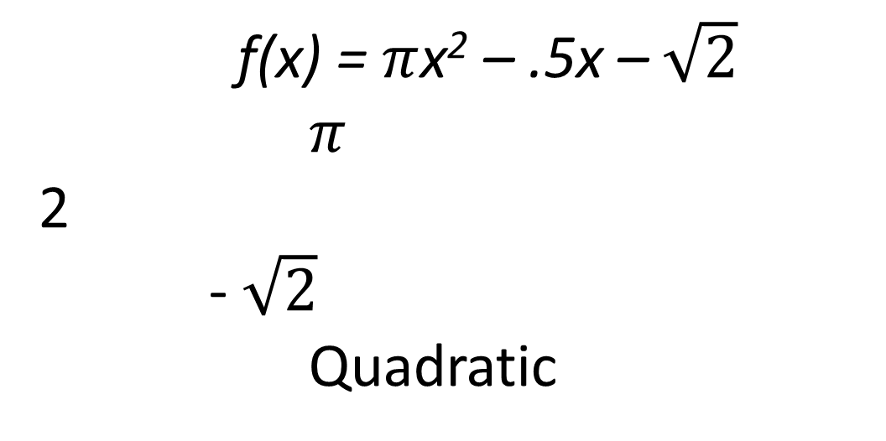

Ex 3
f(x) = -.5x + $π$x² – $\sqrt{2}$
Standard Form:
Leading Coefficient:
Degree:
Constant Term:
Type of Polynomial:
f(x) = $π$x² – .5x – $\sqrt{2}$
$π$
2
- $\sqrt{2}$
Quadratic

Slide 8
Now Try
Decide whether the function is a polynomial function. If it is, write it in standard form and identify the leading coefficient, degree, constant term, and type of polynomial
1) f(x) = 6 – 4x + $π$x⁴ 2) 2$\sqrt{x}$ + 5x – 8 3) f(x) = 9
Std: Std: Std:
LC: LC: LC:
Deg: Deg: Deg:
Const. Term: Const. Term: Const. Term:
Type: Type: Type:

Slide 9
Evaluating a Polynomial Function
*If we don’t have a calculator, we can use synthetic division
Ex:
Evaluate f(-2) of f(x) = 4x⁴ + 2x³ – x + 7
*Rewrite the polynomial in standard form including missing terms (use a coefficient of 0)
f(x) = 4x⁴ + 2x³ + 0x² – x + 7

Slide 10
Evaluating a Polynomial Function Continued
*Take every coefficient, including zero and create a table
*Bring down first
coefficient
4
2
0
-
1
7
*Multiply
*Add
*Repeat
-
2
-
8
12
-
24
50
4
-
6
12
-
25
57
f(-2) = 57

Slide 11


Ex 2
Evaluate $f\left(\frac{−1}{2}\right)if f\left(x\right)=4x^{3}−2x^{2}+x−3$
$$\frac{1}{2}$$
4
-2
1
-
3
-
-
2
2
-
$$\frac{3}{2}$$
4
-
4
3
- $\frac{9}{2}$
f($\frac{−1}{2}$) = $\frac{−9}{2}$

Slide 12
Now Try
f(x) = x³ + 5x² + 4x + 6; x = 2
f(x) = 2x³ + x⁴ + 5x² – x; x = -3
f(x) = x³ – x⁵ + 3; x = -1

Slide 13
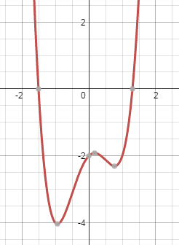
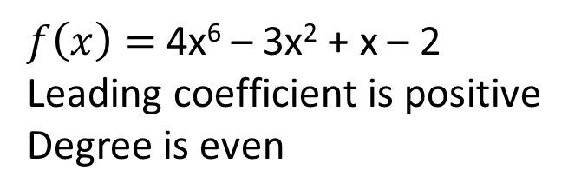
Graphing Polynomial Functions
End Behavior
If leading coefficient is positive and degree is even, then
As $x −∞, f\left(x\right) ∞$
As $x ∞, f\left(x\right) ∞$
$f\left(x\right)=$ 4x⁶ – 3x² + x – 2
Leading coefficient is positive
Degree is even

Slide 14
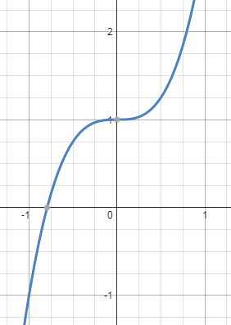
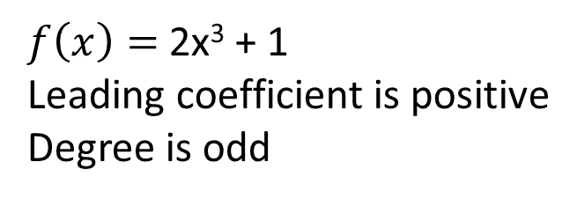
End Behavior
If leading coefficient is positive and degree is odd, then
As $x −∞, f\left(x\right) −∞$
As $x ∞, f\left(x\right) ∞$
$f\left(x\right)=$ 2x³ + 1
Leading coefficient is positive
Degree is odd

Slide 15
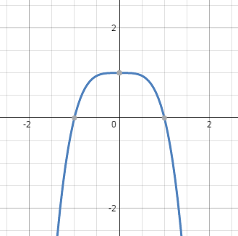
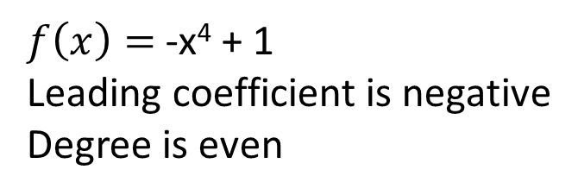
End Behavior
If leading coefficient is positive and degree is even, then
As $x −∞, f\left(x\right) −∞$
As $x ∞, f\left(x\right) −∞$
$f\left(x\right)=$ -x⁴ + 1
Leading coefficient is negative
Degree is even

Slide 16
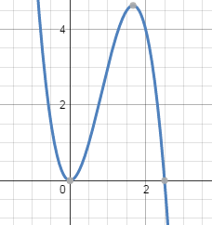
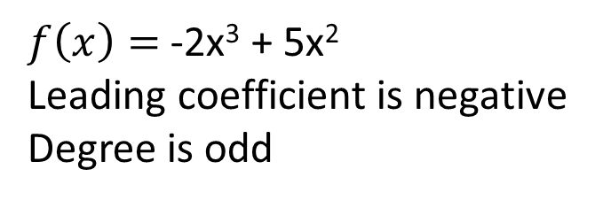
End Behavior
If leading coefficient is positive and degree is even, then
As $x −∞, f\left(x\right) ∞$
As $x ∞, f\left(x\right) −∞$
$f\left(x\right)=$ -2x³ + 5x²
Leading coefficient is negative
Degree is odd

Slide 17
Now Try
From 1985 – 1995, the number of graduates in nursing school in the U.S. can be modeled by
y = -.036t⁴ + .605t³ – 1.87t² – 4.67t + 82.5
Given this model, would you expect the number of nursing grads in 2015 to be greater or less than that in 1995?

