Slide 1

Opening Questions
Evaluate each expression
2⁴ 2) (-2)⁴ 3) -2⁴
4) 2³ 5) -2³ 6) ($\frac{1}{2}$)⁵

Slide 2
6.1: Using Properties of Exponents
Objective: Use properties of exponents to evaluate and simplify expressions involving powers

Slide 3
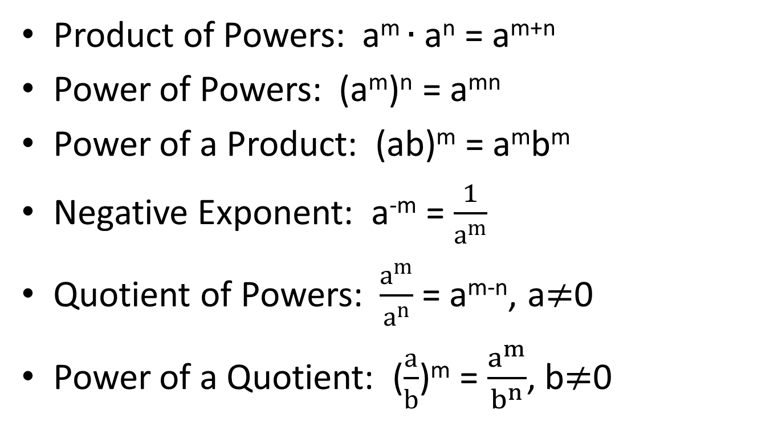
Properties of Exponents
Product of Powers: a^{m} $∙$ a^{n} = a^{m+n}
Power of Powers: (a^{m})^{n} = a^{mn}
Power of a Product: (ab)^{m} = a^{m}b^{m}
Negative Exponent: a^{-m} = $\frac{1}{a^{m}}$
Quotient of Powers: $\frac{a^{m}}{a^{n}}$ = a^{m-n}, a$≠$0
Power of a Quotient: ($\frac{a}{b}$)^{m} = $\frac{a^{m}}{b^{n}}$, b$≠$0

Slide 4
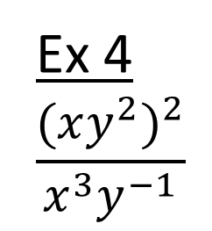
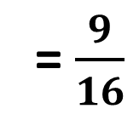
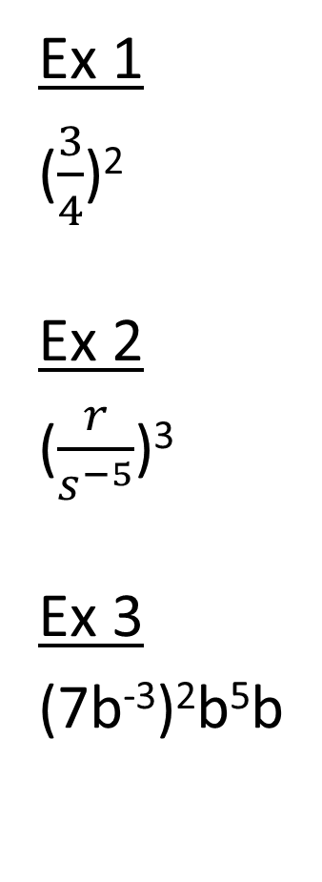
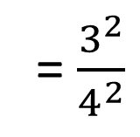

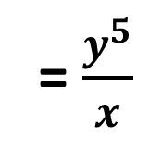
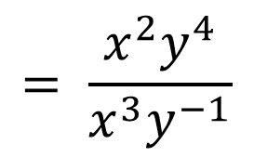
Simplifying/Evaluating Expressions
Ex 1
($\frac{3}{4}$)²
Ex 2
($\frac{r}{s^{−5}}$)³
Ex 3
(7b⁻³)²b⁵b
Ex 4
$$\frac{{(xy^{2})}^{2}}{x^{3}y^{−1}}$$
= $\frac{3^{2}}{4^{2}}$
= $\frac{9}{16}$
$$= \frac{x^{2}y^{4}}{x^{3}y^{−1}}$$
= x⁻¹ y⁵
= $\frac{r^{3}}{s^{−15}}$
= $\frac{y^{5}}{x}$
= r³s¹⁵
= 7²b⁻⁶b⁶
= 7²b⁰
= 49

Slide 5

Now Try
(2x²)⁵ 2) $\frac{y^{−2}}{y^{3}}$
3) 3⁵ $∙$ 3⁻⁵ 4) $\frac{({{2x}^{2})}^{3}}{5}$ $∙$ $\frac{15x^{−2}}{2x^{3}}$

Slide 6
Solving Expressions Using Properties of Exponents
Ex 1
4^{x-1} = 4²
*Same base, set exponents equal
X – 1 = 2
X = 3

Slide 7
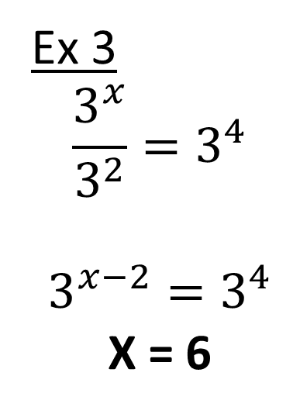
Ex 2
2^{x}2² = 2⁵
2^{x+2} = 2⁵
X = 3
Ex 3
$$\frac{3^{x}}{3^{2}}=3^{4}$$
$$3^{x−2}=3^{4}$$
X = 6

Slide 8
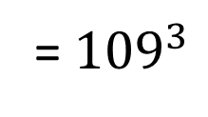
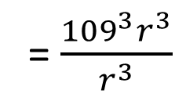
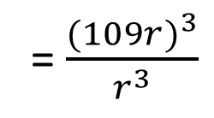
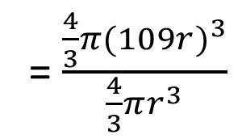
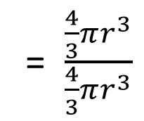
Real Life Application
The radius of the sun is 109 times as great as Earth’s radius. How many times as great as Earth’s volume is the sun’s volume?
*Volume of a sphere is V = $\frac{4}{3}πr^{3}$
$$\frac{Sun^{′}s Volume}{Earth^{′}s Volume}$$
= $\frac{\frac{4}{3}πr^{3}}{\frac{4}{3}πr^{3}}$
Sun’s radius is 109 times that of Earth
= $\frac{\frac{4}{3}π{(109r)}^{3}}{\frac{4}{3}πr^{3}}$
= $\frac{({109r)}^{3}}{r^{3}}$
= $\frac{{109}^{3}r^{3}}{r^{3}}$
= ${109}^{3}$
= 1,295,029 times greater

Slide 9
Scientific Notation
*Instead of giving the answer as a number in millions, we can represent it in scientific notation
*Scientific notation is always written as a number between -10 and 10 multiplied by 10 to some exponent
*If the exponent is positive, move the decimal that many places to the right
*If the exponent is negative, move the decimal that many places to the left

Slide 10
Ex 1
1,295,029
= 1.295029 x 10⁶
Ex 2
0.000000025
= 2.5 x 10⁻⁸

Slide 11
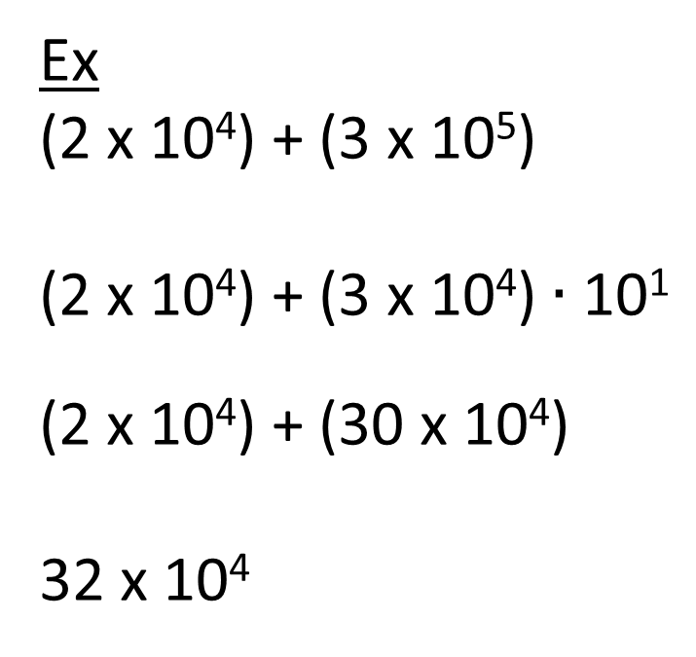
Mathematical Operations and Scientific Notation
*If adding/subtracting numbers in scientific notation, get common base 10’s
Ex
(2 x 10⁴) + (3 x 10⁵)
(2 x 10⁴) + (3 x 10⁴)$∙$ 10¹
(2 x 10⁴) + (30 x 10⁴)
32 x 10⁴
Pull out one base 10 to match
with first term
Multiply with 3
*Now that they have the
same base 10, treat base 10
as a variable
= 3.2 x 10⁵

Slide 12

Ex 2
(7 x 10⁸) – (4 x 10⁶)
10² $∙$ (7 x 10⁶) – (4 x 10⁶)
(700 x 10⁶) – (4 x 10⁶)
696 x 10⁶
6.96 x 10⁸
*Common base 10 is 10⁶

Slide 13
*If multiplying/dividing, you don’t need the same base 10. Simply use properties of exponents
Ex1
(5.2 x 10⁴)(4.7 x 10⁶)
Multiply
= 24.44 x 10¹⁰
= 2.444 x 10¹¹
Multiply

Slide 14

Ex 2
$$\frac{3.45 x {10}^{−3} }{.25 x {10}^{−7}}$$
Divide
Divide
13.8 x 10⁴
1.38 x 10⁵

Slide 15

Now Try
(.82 x 10²)(.2 x 10⁵) 2) (3 x 10⁴) + (6 x 10⁸)
3) (7 x 10⁹) – (6 x 10⁵) 4) $\frac{21 x {10}^{−7}}{4 x {10}^{2}}$

