Slide 1
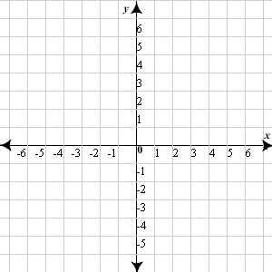
Opening Questions
Graph the inequalities
y > -x + 1 2) y < 2x + 2 3) –x < y
x – 2y > 4

Slide 2
5.7: Graphing and Solving Quadratic Inequalities
Objective: Graph quadratic inequalities in two variables
Solve quadratic inequalities in one variable

Slide 3
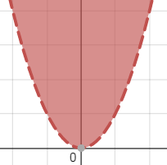
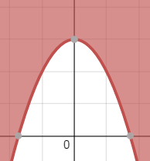
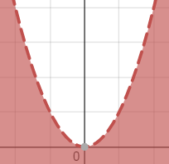
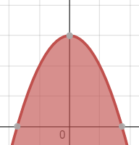
Graphing Quadratic Inequalities
*All the rules for graphing linear inequalities apply to quadratic inequalities
>, <:
>, <:
Dashed line
>, >:
Solid Line
<, <:

Slide 4
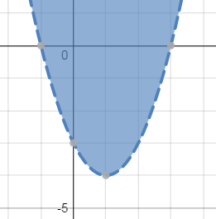
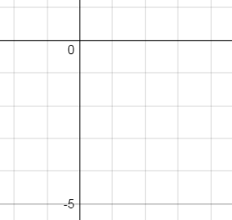
Graphing by Hand
Ex 1: y > x² – 2x – 3
Intercept Form
*Factor
y > (x – 3)(x + 1)
Intercepts @ x = -1, 3
Vertex @ (1,-4)
Vertex Form
*Complete the Square
y + C > x² – 2x + C – 3
C =$({\frac{−2}{2})}^{2}$ = 1
y + 1 > x² – 2x + 1 – 3
y > (x – 1)² – 4

Slide 5
Now Try
1) -y < -x² + 4
Vertex Form
Intercept Form

Slide 6
Graphing a System of Quadratic Inequalities
*Just like graphing systems of linear inequalities, we are looking for the overlapping area
Ex
y > x² – 4
y < -x² – x + 2
Intercept Form
y > x² – 4
y < -x² – x + 2
y > (x – 2)(x + 2)
y < -1(x² + x – 2)
y < -(x + 2)(x – 1)
y > (x – 2)(x + 2) y < -(x + 2)(x – 1)

Slide 7
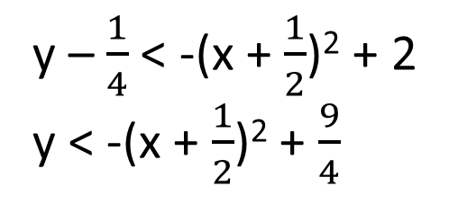
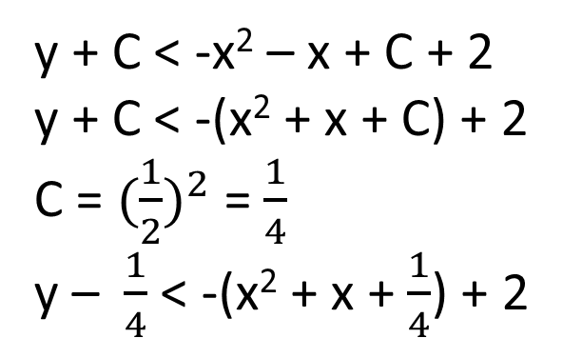
Ex 1 Continued
Intercept Form: y > (x – 2)(x + 2) y < -(x + 2)(x – 1)
y > x² – 4
y < -x² – x + 2
Vertex Form:
y > x² – 4
y < -x² – x + 2
y + C > x² + 0x + C – 4
y + 0 > x² + 0x + 0 – 4
y > (x – 0)² – 4
C = 0
Vertex @ (0,-4)
y + C < -x² – x + C + 2
y + C < -(x² + x + C) + 2
C = ${(\frac{1}{2})}^{2}$ = $\frac{1}{4}$
y – $\frac{1}{4}$ < -(x² + x + $\frac{1}{4}$) + 2
y – $\frac{1}{4}$ < -(x + $\frac{1}{2}$)² + 2
y < -(x + $\frac{1}{2}$)² + $\frac{9}{4}$
Vertex @ (- $\frac{1}{2}$, $\frac{9}{4}$)

Slide 8
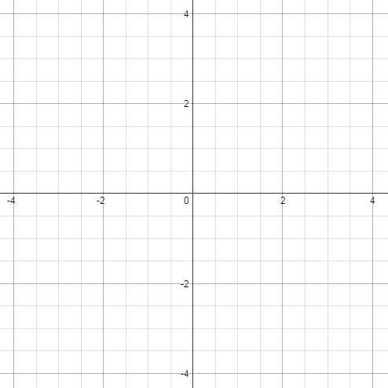
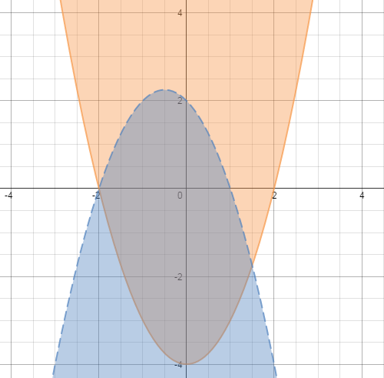
Ex 1 Continued
y > x² – 4 :
y < -x² – x + 2:
Intercepts @ x = $±$2
Vertex @ (0,-4)
Intercepts @ x = -2, 1
Vertex @ ($−\frac{1}{2},\frac{9}{4})$

Slide 9
Now Try
y > x²
y < 4x – x²

Slide 10
Graphing Quadratic Inequalities Using Your Graphing Calculator
*If you are allowed to use your graphing calculator to graph a quadratic or multiple quadratics, you should always find three things before you copy it down to paper
Vertex
Intercepts
Intersection points of quadratics (if graphing a system of quadratics)

Slide 11
Finding the Vertex
When finding the vertex of a quadratic, you are finding the min/max of that graph
If your graph opens downward, a hill is created; you’re finding a max
If your graph opens upward, a valley is created; you’re finding a min
2nd, calc, min/max
*You have do identify an interval of how far left and right you’re looking

Slide 12
Finding X-Intercepts
You’re finding where the graph crosses the x-axis
2nd, calc, zero
*You have to identify an interval
Finding Intersections
You’re finding where graphs cross each other
2nd, calc, intersection

Slide 13
Now Try
Identify the vertex, x-intercepts, and intersections if applicable
y < x² + 2 2) y > -x² + 2x 3) y < $\frac{1}{2}$x² + x – 2
Vertex: Vertex: Vertex:
Intercepts: Intercepts: Intercepts:
y > 2x² + 5x
y < -x² – 2x – 3
Vertex:
Intercepts:
Intersections:
Vertex:
Intercepts:

