Slide 1
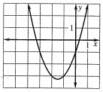
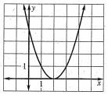
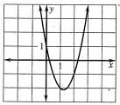
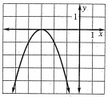
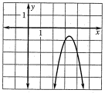
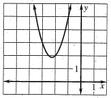
Opening Questions
For each equation, compute b² – 4ac. Then use the graph to determine the number of solutions.
x² + 3x – 1 = 0 2) x² – 4x – 4
2x² – 5x + 1 = 0 4) -x² – 6x – 9 = 0
5) -3x² + 20x – 34 = 0 6) 2x² + 9x + 12 = 0

Slide 2
5.6: The Quadratic Formula and the Discriminant
Objective: Solve quadratic equations using the quadratic formula

Slide 3
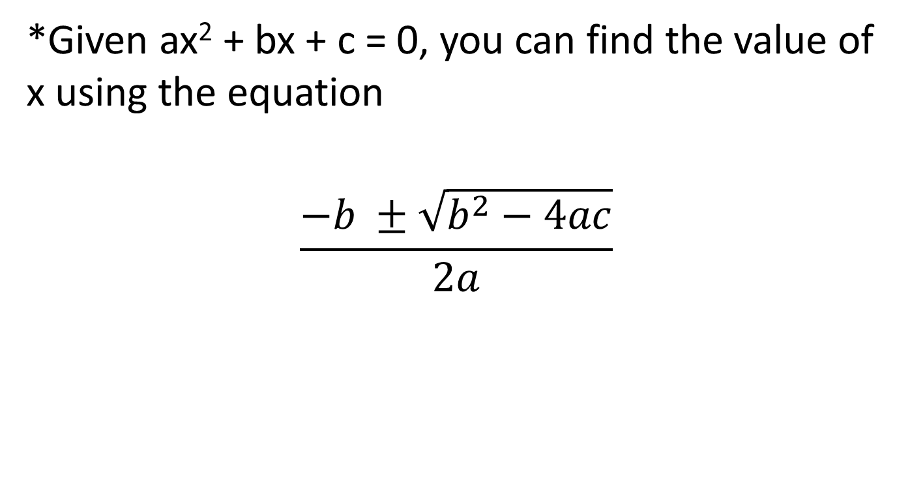
Quadratic Formula
*Given ax² + bx + c = 0, you can find the value of x using the equation
$$\frac{−b ±\sqrt{b^{2}−4ac}}{2a}$$

Slide 4

Ex 1
x² + 9x + 14 = 0
*We know this can factor into (x+7)(x+2) = 0, so x = -2, -7
$$\frac{−b ±\sqrt{b^{2}−4ac}}{2a}$$
$$\frac{−9 ±\sqrt{{(9)}^{2} −4(1)(14)}}{2(1)}$$
$$\frac{−9 ±\sqrt{81−56}}{2}$$
$$\frac{−9 ±\sqrt{25}}{2}$$
$$\frac{−9 ±5}{2}$$
$$\frac{−9+5}{2} and \frac{−9−5}{2}$$
$$x=−2 and −7$$

Slide 5

Ex 2
2x² + x = 5
2x² + x – 5 = 0
$$\frac{−1±\sqrt{{(1)}^{2}−4(2)(−5)}}{2(2)}$$
$$\frac{−1±\sqrt{1+40}}{4}$$
$$\frac{−1+\sqrt{41}}{4} and \frac{−1−\sqrt{41}}{4}$$

Slide 6
Now Try
2x² + x = x² – 2x + 4 2) x² – x = 5x – 9
3) –x² + 2x = 2 4) -2x² = -2x + 3

Slide 7
Using the Discriminant
*You have just done four problems with three different outcomes
Two real solutions
One real solution
Two imaginary solutions
*You can find out what type of solutions a quadratic will have by using the discriminant
$$\frac{−b±\sqrt{b^{2}−4ac}}{2a}$$
discriminant

Slide 8
If b² – 4ac > 0, the equation has two real solutions
If b² – 4ac = 0, the equation has one real solution
If b² – 4ac < 0, the equation has two imaginary solutions

Slide 9
Ex
x² – 6x + 10 = 0
b² – 4ac
(-6)² – 4(1)(10)
36 – 40
-4
*Two Imaginary Solutions
x² – 6x + 9 = 0
b² – 4ac
(-6)² – 4(1)(9)
36 – 36
0
*One Real Solution
x² – 6x + 8 = 0
b² – 4ac
(-6)² – 4(1)(8)
36 – 32
4
*Two Real Solutions

Slide 10
Now Try
Use the discriminant to state how many solutions the quadratic will have
9x² + 6x + 1 = 0 2) 9x² + 6x + -4 = 0
3) 9x² + 6x + 5 = 0

