Slide 1
Opening Questions
Solve the equations
(x – 2)² = 16 2) 3(x + 5)² = 24
3) 11(x – 7)² – 3 = 19

Slide 2
5.5: Completing the Square
Objective: Solve quadratic equations by completing the square
Use completing the square to write quadratic functions

Slide 3
Completing the Square
*Completing the square is a process that allows you to write an expression of the form x² + bx as a perfect square of a trinomial.
Formula for Completing the Square
x² + bx + ($\frac{b}{2}$)² = (x + $\frac{b}{2}$)²

Slide 4
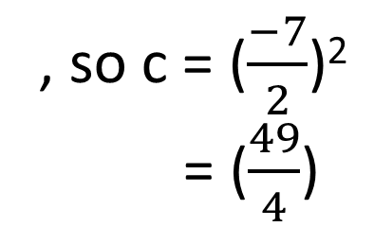
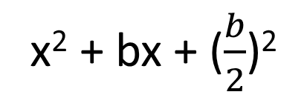
Ex
Find the value of c that makes x² – 7x + c a perfect square trinomial. Then write the expression as the square of a binomial.
x² + bx + ($\frac{b}{2}$)²
c
, so c = ($\frac{−7}{2}$)²
= ($\frac{49}{4}$)
x² – 7x + $\frac{49}{4}$, we can factor into (x – $\frac{7}{2}$ )²

Slide 5
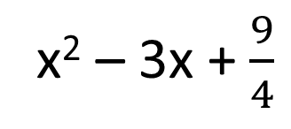
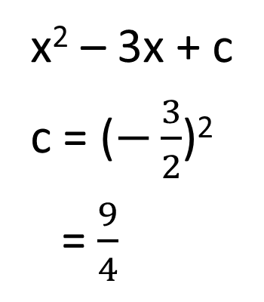
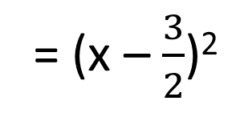
Ex 2
x² – 3x + c
c = ($−\frac{3}{2}$)²
= $\frac{9}{4}$
x² – 3x + $\frac{9}{4}$
= (x – $\frac{3}{2}$)²

Slide 6
Now Try
x² + 6x + C 2) x² – 12x + C
3) x² + 2x + C

Slide 7

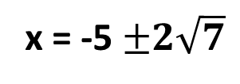
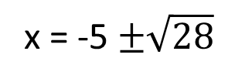
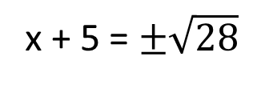
Solving a Quadratic Equation if the Coefficient of x² is 1
Ex
x² + 10x – 3 = 0
*Want x’s on one side, constants on the other
x² + 10x = 3
*Now complete the square by finding C like in the previous problems
C = ($\frac{b}{2}$)²
= ($\frac{10}{2}$)²
= (5)²
= 25
*Add C into your equation. Remember if we add something to one
side, we have to do it to the other side as well
x² + 10x + C = 3 + C
x² + 10x + 25 = 3 + 25
*Factor the left hand side and solve
(x + 5)² = 28
x + 5 = $±\sqrt{28}$
x = -5 $±\sqrt{28}$
x = -5 $±2\sqrt{7}$

Slide 8
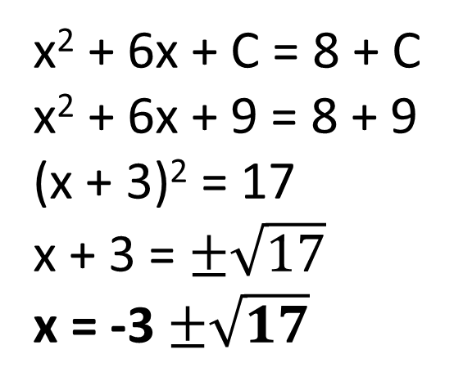
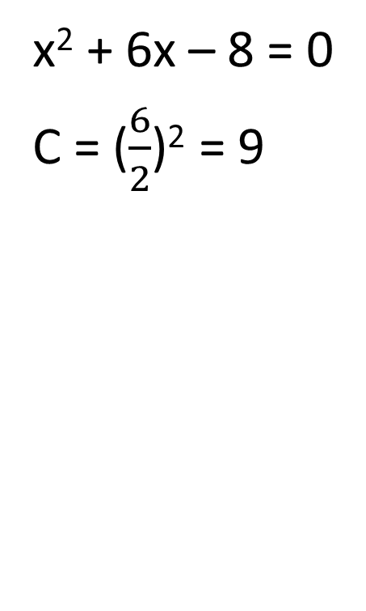
Ex 2
x² + 6x – 8 = 0
C = ($\frac{6}{2}$)² = 9
x² + 6x + C = 8 + C
x² + 6x + 9 = 8 + 9
(x + 3)² = 17
x + 3 = $±\sqrt{17}$
x = -3 $±\sqrt{17}$

Slide 9
Now Try
x² – x = 1 2) x² + 6x + 5 = 0
3) x² = 4x - 13

Slide 10

Solving a Quadratic Equation if the Coefficient Isn’t 1
Ex
3x² – 6x + 12 = 0
*Divide both sides by the leading coefficient
x² – 2x + 4 = 0
*Now complete the square
C = ($\frac{−2}{2}$)² = 1
x² – 2x + C = -4 + C
x² – 2x + 1 = -4 + 1
(x – 1)² = -3
x – 1 = $±\sqrt{−3}$
x – 1 = $±i\sqrt{3}$
x = 1 $±i\sqrt{3}$

Slide 11
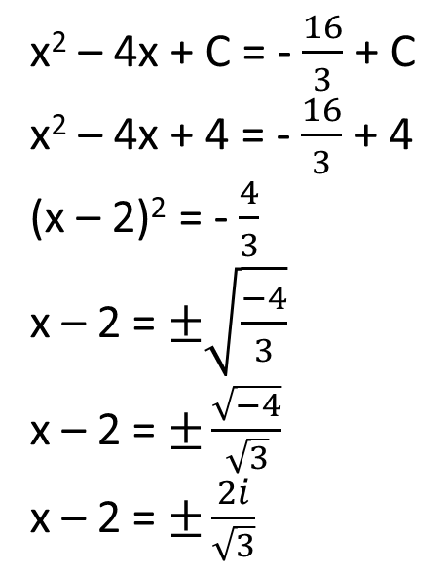
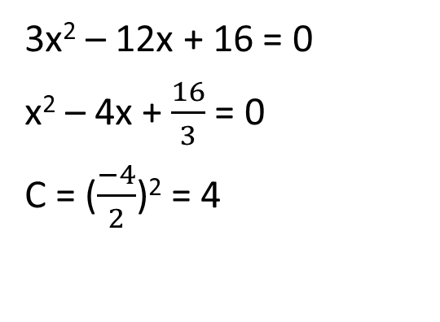
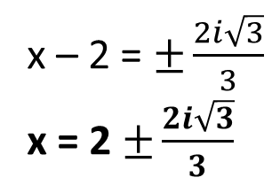

Ex 2
3x² – 12x + 16 = 0
x² – 4x + $\frac{16}{3}$ = 0
C = ($\frac{−4}{2}$)² = 4
x² – 4x + C = -$\frac{16}{3}$ + C
x² – 4x + 4 = - $\frac{16}{3}$ + 4
(x – 2)² = - $\frac{4}{3}$
x – 2 = $±\sqrt{\frac{−4}{3}}$
x – 2 = $±\frac{\sqrt{−4}}{\sqrt{3}}$
x – 2 = $±\frac{2i}{\sqrt{3}}$
$$∙\frac{\sqrt{3}}{\sqrt{3}}$$
x – 2 = $±\frac{2i\sqrt{3}}{3}$
x = 2 $±\frac{2i\sqrt{3}}{3}$

Slide 12
Now Try
4x² + 24x – 8 = 0 2) 3x² + 12x – 9
3) 3x² + 4x + 2 = x² + 6x

Slide 13
Writing Quadratic Functions in Vertex Form
*Remember, vertex form is y = (x – h)² + k
A perfect square
Ex
Write the quadratic equation y = x² – 8x + 11 vertex form. What is the
vertex of the equation?
*Keep the 11 on the right hand side
y + C = x² – 8x + C + 11
Complete the square

Slide 14
Ex 1 Continued
y + C = x² – 8x + C + 11
Complete the square
C = ($\frac{−8}{2}$)² = (-4)² = 16
y + 16 = x² – 8x + 16 + 11
*Don’t add C to 11, factor the perfect square
y + 16 = (x – 4)² + 11
*Solve for y
y = (x – 4)² – 5
Vertex @ (-h, k)
(4, -5)

Slide 15
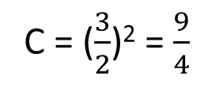
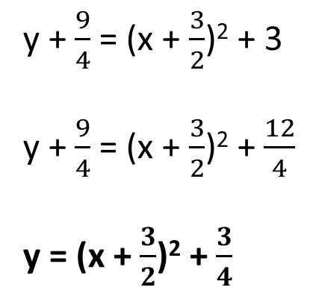
Ex 2
Write the quadratic equation y = x² + 3x + 3 in vertex form. What is the vertex of the equation?
y = x² + 3x + 3
y + C = x² + 3x + C + 3
C = ($\frac{3}{2}$)² = $\frac{9}{4}$
y + $\frac{9}{4}$ = x² + 3x + $\frac{9}{4}$ + 3
y + $\frac{9}{4}$ = (x + $\frac{3}{2}$)² + 3
y + $\frac{9}{4}$ = (x + $\frac{3}{2}$)² + $\frac{12}{4}$
y = (x + $\frac{3}{2}$)² + $\frac{3}{4}$
Vertex @ (- $\frac{3}{2}$, $\frac{3}{4}$)

Slide 16
Ex 3
y = -2x² – 4x – 7
y + C = -2x² – 4x + C – 7
*Divide so you don’t have a leading coefficient
y + C = -2(x² + 2x + C) – 7
C = ($\frac{2}{2}$)² = 1
y – 2 = -2(x² + 2x + 1) – 7
y – 2 = -2(x + 1)² – 7
y = -2(x + 1)² – 5
*Dividing a constant by an number is still a
constant
You add 1 to the right side, but keep
in mind you are multiplying the C by
-2, so you must add -2 to the left
side

Slide 17

Ex 4
y = -3x² + 6x – 8
y + C = -3x² + 6x + C – 8
y + C = -3(x² – 2x + C) – 8
C = ($\frac{−2}{2}$)² = (-1)² = 1
y – 3 = -3(x² – 2x + 1) – 8
y – 3 = -3(x – 1)² – 8
y = -3(x – 1)² – 5

Slide 18
Now Try
y = x² + 8x + 2 2) y = x² – 4x + 10
3) y = x² – 2x – 5 4) y = -x² + 4x – 1

