Slide 1
Opening Questions
Solve the equation
2(x – 3)² = 8 2) 4(x + 1)² = 100
3) 5(x – 7)² = 135 4) x² + 26 = -10

Slide 2
5.4: Complex Numbers
Objective: Solve quadratic equations with complex solutions

Slide 3
Vocab
Imaginary Unit – represented by “i.” i = $\sqrt{−1}$, i² = -1. We can use i to represent the square root of any negative number.
Complex Number – a number “a + bi” where “a” and “b” are real numbers. “a” is the real part, “bi” is the imaginary part.
Imaginary Number – a complex number where b $≠$ 0.
Pure Imaginary Number – a complex number where
a = 0 and b $≠$ 0. i.e. “0 + bi”

Slide 4
Complex Numbers (a + bi)
Real Numbers
(a + 0i)
Imaginary Numbers
(a + bi)
2 + 3i
5 – 5i
-1
$$\frac{5}{2}$$
Pure Imaginary (bi)
3
-4i
6i
$$π$$

Slide 5
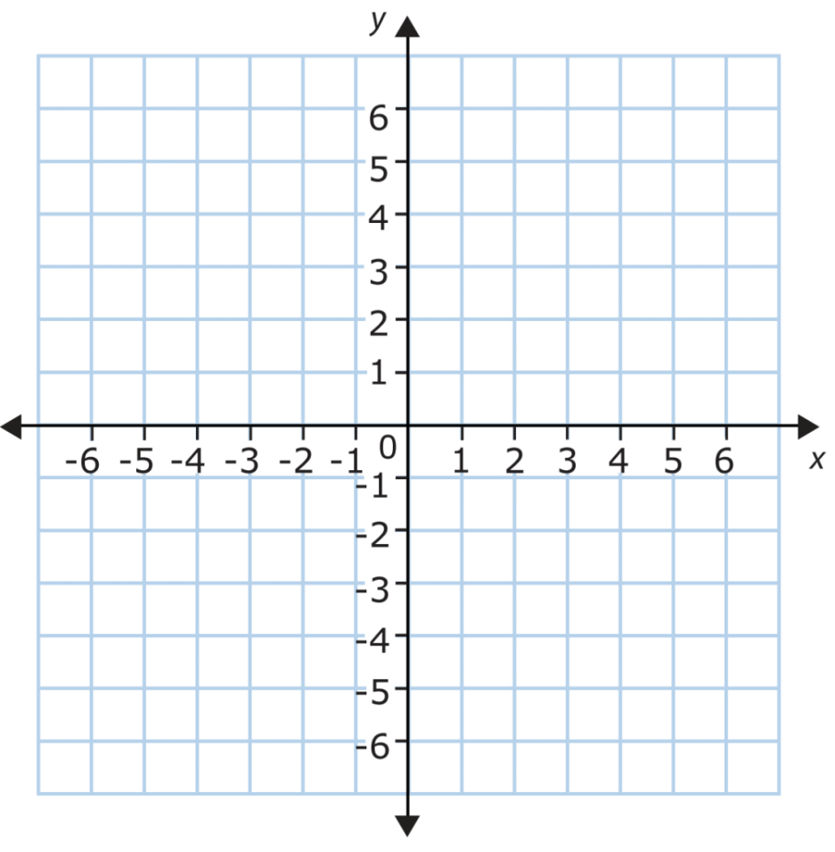
Plotting Complex Numbers
*When plotting complex numbers, replace the y-axis with imaginary numbers. The x-axis becomes real numbers
Plot
a) 2 – 3i b) -3 + 2i
c) 4i

Slide 6
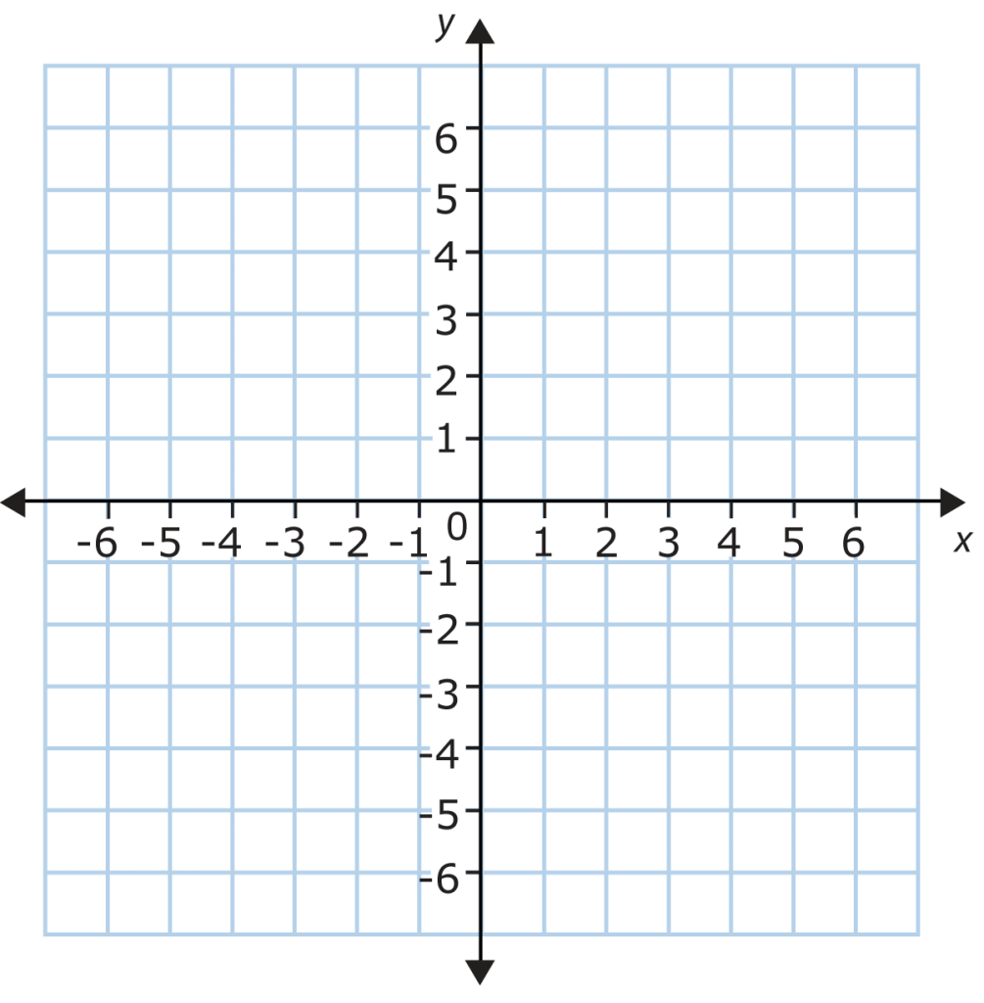
Now Try
Plot
-4 – i
5
1 + 3i

Slide 7
Adding and Subtracting Complex Numbers
*Treat i as a variable
Ex
(4 – i) + (3 + 2i)
7 + i
Ex 2
6 – (-2 + 9i) – (8 – 4i)
6 + 2 – 9i – 8 + 4i
-5i

Slide 8
Now Try
(7 – 5i) – (1 – 5i) 2) (-1 + 2i) + (3 + 3i)
3) (2 – 3i) – (3 – 7i) 4) 2i – (3 + i)+(2 – 3i)

Slide 9
Multiplying Complex Numbers
*If i is raised to an odd exponent, it will remain i ex: i, i³ = i, i⁵ = i…
*If i is raised to an even exponent, it will become -1
ex: i² = -1, i⁴ = -1, i⁶ = -1
Ex:
5i(-2 + i)
-10i + 5i²
-10i + 5(-1)
-10i – 5
- 5 – 10i
Ex 2:
(7 – 4i)(-1 + 2i)
-7 + 14i + 4i – 8i²
-7 + 18i – 8(-1)
-7 + 18i + 8
1 + 18i
Ex 3:
(6 + 3i)(6 – 3i)
*Difference of two squares
36 – 9i²
36 – 9(-1)
36 + 9
45

Slide 10
Now Try
3i(9 – i) 2) (-1 + 4i)(3 – 6i) 3) -2i(5 + i)
(2 + 3i)(2 – 3i) 5) (4 – i)(-2 + 6i) 6) (5 + 3i)²
7) (8 + i)(2 + i)

Slide 11
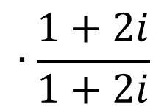
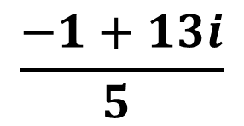
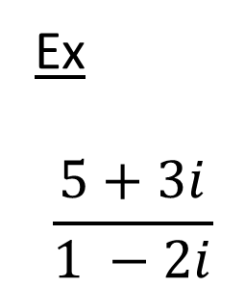
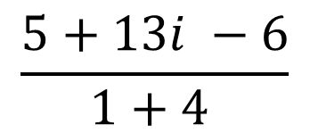
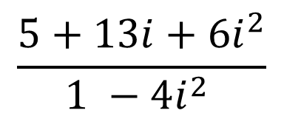
Dividing Complex Numbers
*When dividing by complex numbers, you have to multiply by the conjugate
Ex
$$\frac{5+3i}{1 −2i}$$
$$∙\frac{1+2i}{1+2i}$$
$$\frac{5+10i+3i+6i^{2}}{1 −4i^{2} }$$
=
$$\frac{5+13i+6i^{2}}{1 −4i^{2} }$$
=
conjugate
$$\frac{5+13i −6}{1+4 }$$
$$\frac{−1+13i}{5 }$$
=
=

Slide 12
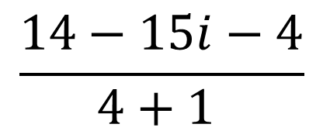
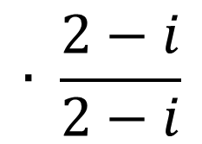
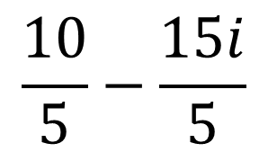
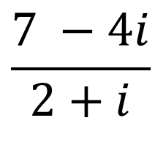
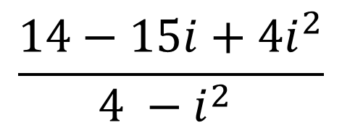
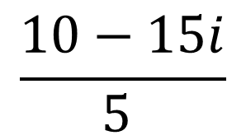
Ex 2
$$\frac{7 −4i}{2+i}$$
$$∙ \frac{2−i}{2−i}$$
$$\frac{14−7i−8i+4i^{2}}{4 −i^{2} }$$
$$=$$
$$\frac{14−15i+4i^{2}}{4 −i^{2} }$$
$$=$$
$$\frac{14−15i−4}{4+1 }$$
$$=$$
$$\frac{10−15i}{5 }$$
$$\frac{10}{5}−\frac{15i}{5}$$
$$=$$
$$=$$
= 2 – 3i

Slide 13

Now Try
1) $\frac{6}{1−i}$ 2) $\frac{5i}{2+i}$ 3)$\frac{2−3i}{5i}$
4) $\frac{1−i}{1+i}$ 5) $\frac{3+i}{−2+i}$ 6)$\frac{2−i}{\sqrt{3}−i}$

