Slide 1
Opening Questions
Evaluate the expression. Round your answer to the nearest hundredth
1) $\sqrt{36}$ 2) $\sqrt{4}$ $∙ \sqrt{9}$
3) $\sqrt{8}$ 4) $\sqrt{4} ∙ \sqrt{2}$

Slide 2
5.3: Solving Quadratic Equations by Finding Square Roots
Objective: Solve quadratic equations by finding square roots
Use quadratic equations to solve real life problems

Slide 3

Properties of Radicals
$$\sqrt{ab }= \sqrt{a}∙\sqrt{b}$$
$$\sqrt{\frac{a}{b}}= \frac{\sqrt{a}}{\sqrt{b}}$$

Slide 4
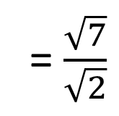

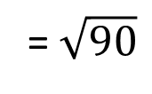
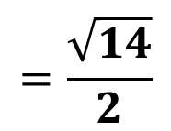

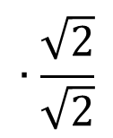
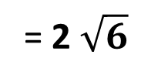
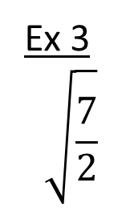
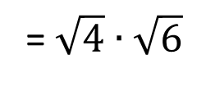

Simplifying Radicals
* Find the factors of the number that you can
take the square root of
Ex
$$\sqrt{24}$$
= $\sqrt{4∙2}$
= $\sqrt{4}∙\sqrt{6}$
= 2 $\sqrt{6}$
Ex 2
$$\sqrt{6}∙\sqrt{15}$$
= $\sqrt{90}$
$=\sqrt{9}∙$ $\sqrt{10}$
= $3\sqrt{10}$
*When simplifying a fraction, you can’t have a
radical in the denominator. To fix this, multiply the
fraction by the denominator
Ex 3
$$\sqrt{\frac{7}{2}}$$
= $\frac{\sqrt{7}}{\sqrt{2}}$
$$∙\frac{\sqrt{2}}{\sqrt{2}}$$
$$=\frac{\sqrt{14}}{2}$$

Slide 5

Now Try
1) $\sqrt{500}$ 2) $3\sqrt{12}∙\sqrt{6}$
3) $\sqrt{\frac{25}{3}}$ 4) $\sqrt{\frac{2}{11}}$

Slide 6
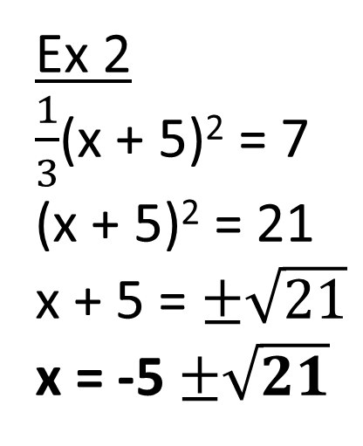
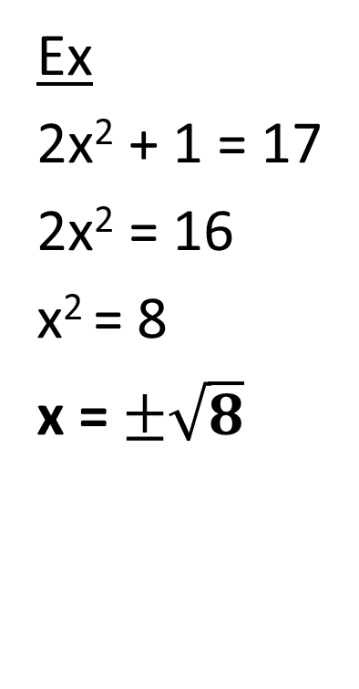
Solving a Quadratic Equation
Ex
2x² + 1 = 17
2x² = 16
x² = 8
x = $±\sqrt{8}$
Ex 2
$\frac{1}{3}$(x + 5)² = 7
(x + 5)² = 21
x + 5 = $±\sqrt{21}$
x = -5 $±\sqrt{21}$

Slide 7

Now Try
1) $\frac{p^{2}}{4} −3=33$ 2) 3 – 5x² = -9
3) 3(x – 2)² = 21 4) 5(x – 7)² = 135

Slide 8
Real Life Application
*When an object is dropped, it can be represented with the function h = -16t² + h₀, where h represents height, t is time, and h₀ is the initial height
A student man working on the set of a movie is to fall out of a window 100 feet above the ground. For the stunt man’s safety, he will land on an air cushion 26 feet wide by 30 feet long by 9 feet high. How many seconds will the stunt man fall before he reaches the cushion?

Slide 9
Real Life Application Continued
9 = -16t² + 100
-91 = -16t²
$\frac{−91}{−16}$ = t²
$±\sqrt{\frac{91}{16}}$ = t
*Simplify
$±\frac{\sqrt{91}}{\sqrt{16}}=\frac{\sqrt{91}}{4}$ $≈±2.41$
*Can’t have negative
seconds, so the stunt man will
hit the cushion around 2.41
seconds
h = -16t² + h₀
Height:
Time:
Initial height:
9
t
100

Slide 10
Now Try
The tallest building in the U.S. is in Chicago. It is 1,450 feet tall. How long will it take a penny to drop from the top of the building?

