Slide 1
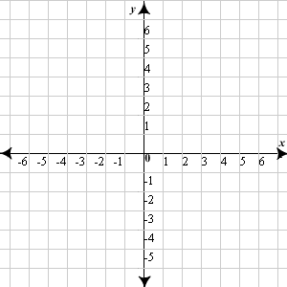
Opening Questions
Use the equation y = x². Evaluate three values of x < 0 and three values of x > 0. Graph the corresponding coordinate points

Slide 2
5.1: Graphing Quadratic Functions
Objective: Graph quadratic functions

Slide 3
Vocab
Quadratic Function – y = ax² + bx + c where a$≠$0
Parabola – a U-shaped figure that is the result of
a quadratic function
Vertex – the lowest or highest point of a
quadratic function
Axis of Symmetry – an imaginary line that a graph
can be “folded” on and will lie on top of itself

Slide 4
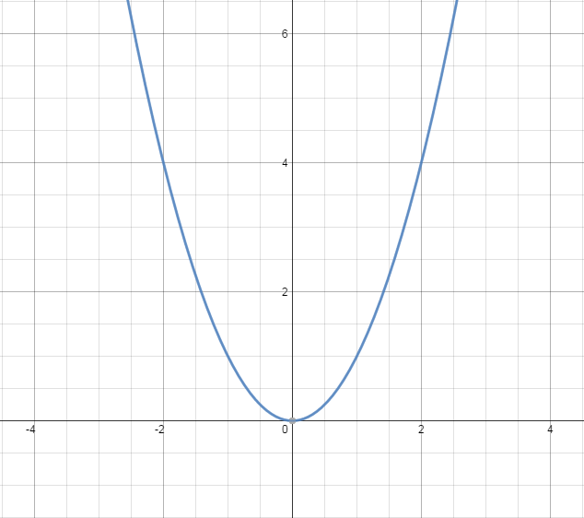
The Graph of a Quadratic Equation
y = x²

Slide 5
Characteristics of a Quadratic Function
f(x) = ax² + bx + c
If a > 0, the graph opens upward. If a < 0, the graph opens downward
If |a|>1, the graph is narrower than f(x)=x². If |a|<1, the graph is wider than f(x)=x²
The x-coordinate of the vertex is $\frac{−b}{2a}$. The y-coordinate is at f($\frac{−b}{2a}$)
The axis of symmetry is the vertical line at the x-coordinate of the vertex

Slide 6
Ex
Graph f(x) = 2x² – 8x + 6
a > 0, opens up
|a| > 1, narrower than f(x) = x²
x-coordinate: $\frac{−b}{2a}= \frac{−(−8)}{2(2)}$ = $\frac{8}{4}$ = 2
y-coordinate: f(2) = 2x² – 8x + 6
2(2)² – 8(2) + 6
2(4) – 16 + 6
8 – 16 + 6
f(2) = -2
Vertex @ (2,-2)
*Find two points on either side of the
axis of symmetry
f(1) = 0
f(0) = 6

Slide 7
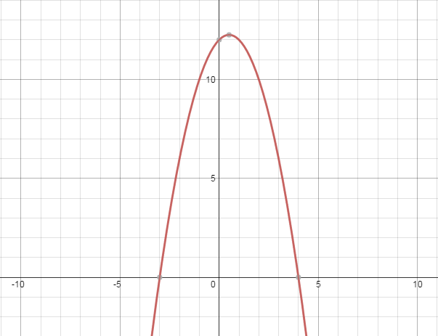
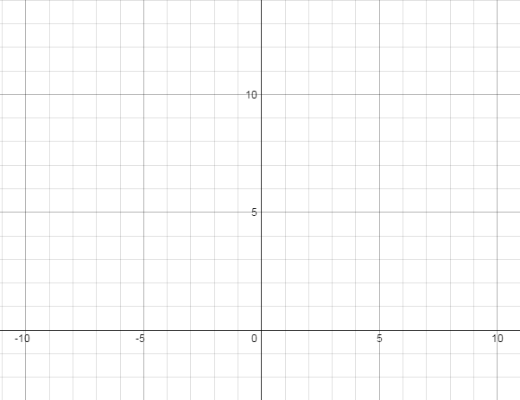
Ex 2
f(x) = -x² + x + 12
Opens downward
Standard width
x-coordinate vertex: $\frac{−1}{2(−1)}$ = $\frac{1}{2}$
y-coordinate vertex:
f($\frac{1}{2}$) = -($\frac{1}{2}$)² + ($\frac{1}{2}$) + 12
- $\frac{1}{4}$ + $\frac{1}{2}$ + 12
- $\frac{1}{4}$ + $\frac{2}{4}$ + $\frac{48}{4}$
$\frac{49}{4}$ = 12.25
Vertex @ ($\frac{1}{2}$, 12.25)
f(0) = 12, f(-1) = 10, f(-2) = 6

Slide 8
Now Try
Graph the following functions
1) f(x) = x² + 2x + 1 2) f(x) = -2x² – 8x – 5

Slide 9
Now Try Continued
3) f(x) = -x² + 4

Slide 10
Other Forms of Quadratic Equations
Vertex Form – f(x) = a(x – h)² + k
* Vertex @ (h,k) * Axis of symmetry @ x = h
Intercept Form – f(x) = a(x – p)(x – q)
* x-intercepts @ (p,0) and (q,0)
*axis of symmetry is halfway between p and q, or @ $\frac{p+q}{2}$
*In both forms, if a > 0, graph opens up
if a < 0, graph opens down
if |a| > 1, graph is narrower than x²
if |a| < 1, graph is wider than x²

Slide 11
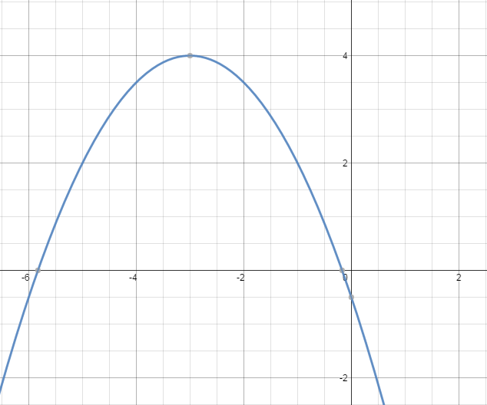
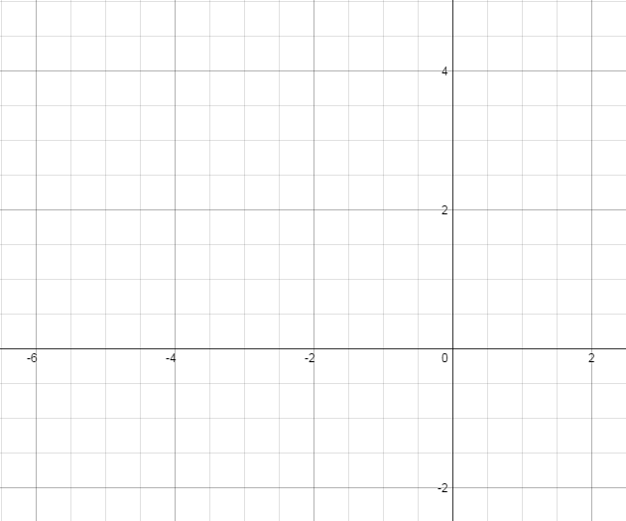

Graphing in Vertex Form
f(x) = - $\frac{1}{2}$(x + 3)² + 4
Opens down
Wide
Vertex @ (-3,4)
f(-2) = 3.5
f(-1) = 2

Slide 12
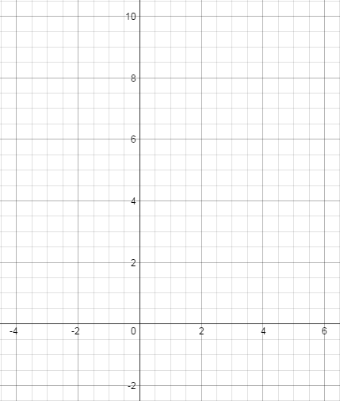
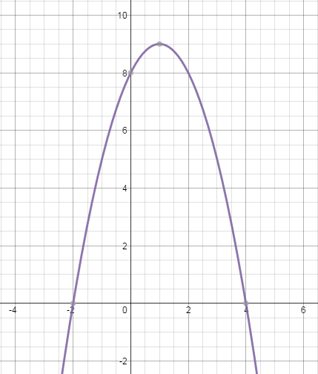
Graphing a Quadratic in Intercept Form
f(x) = -(x + 2)(x – 4)
Opens down
Standard width
x-intercepts @ (-2,0)
(4,0)
x-coordinate of vertex: $\frac{p+q}{2}$
$\frac{−2+4}{2}$ = 1
y-coordinate of vertex:
f(1) = -[(1) + 2][(1) – 4]
-[(3)(-3)]
f(1) = 9
Vertex @ (1,9)

Slide 13
Now Try
Graph the following equations
1) f(x) = -(x+5)² + 2 2) f(x) = 2(x – 3)(x + 1)

Slide 14
Converting to Standard Form
*If x² = x $∙$ x, then (x+5)² = (x+5)(x+5)
*If a quadratic equation is in vertex or intercept form, we can convert it to standard form by using FOIL
First Outside Inside Last

Slide 15
First Outside Inside Last
*When you FOIL, you are multiplying each term
f(x) = (x + 3)(x + 5)
x²
+5x
+3x
+15
x² + 8x + 15
f(x) = -3(x + 1)(x – 5)
-3(x²
– 5x
+ x
– 5)
-3(x² – 4x – 5)
-3x² + 12x + 15

Slide 16
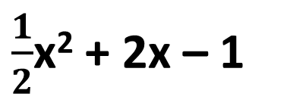
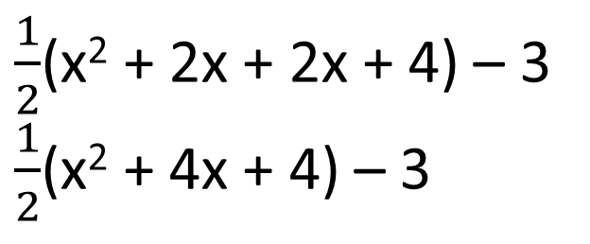
More FOIL
f(x) = 3(x – 1)² + 8
3(x – 1)(x – 1) + 8
3(x² – x – x + 1) + 8
3(x² – 2x + 1) + 8
3x² – 6x + 3 + 8
3x² – 6x + 11
f(x) = $\frac{1}{2}$(x + 2)² – 3
$\frac{1}{2}$(x + 2)(x + 2) - 3
$\frac{1}{2}$(x² + 2x + 2x + 4) – 3
$\frac{1}{2}$(x² + 4x + 4) – 3
$\frac{1}{2}$x² + 2x + 2 – 3
$\frac{1}{2}$x² + 2x – 1

Slide 17
Now Try
f(x) = (x + 1)² – 8 2) y = -4(x + 2)(x – 2)
3) y = 3(x – 2)² + 1 4) f(x) =(x – 3)(x – 6)

