Slide 1
Opening Questions
Solve the Linear System
x – 5y = 10 2) y = 2x + 3
3x – 15y = 15 -4x + 2y = 6
3) x – y = -5
x + 3y = 11

Slide 2
3.6: Solving Systems of Linear Equations in Three Variables
Objective: Solve a system of linear equations in three variables.
Use linear systems in three variables to model real life situations.

Slide 3
Solving by Linear Combination
Take the first two equations and use linear combination to eliminate a variable to create a new equation 4
Take either the first and third or second and third equations and use linear combination method to eliminate the same variable from step 1. This creates a new equation 5
Take equation 4 and 5 and use linear combination to cancel out a variable
Take solution from step 3 and plug into equation 4 or 5. Solve for the other variable
Take solutions from step 3 and step 4 to solve for the last variable

Slide 4
Ex
Step 1:
1
1
3x + 2y + 4z = 11
3x + 2y + 4z = 11
3x + 2y + 4z = 11
2x – y + 3z = 4
5x – 3y + 5z = -1
2( )
2
2
2x – y + 3z = 4
4x – 2y + 6z = 8
3
4
7x + 10z = 19
Step 2:
Step 4:
-3( )
2
2x – y + 3z = 4
-6x + 3y – 9z = -12
-x – 4z = -13
5
-x – 4(4) = -13
-x – 16 = -13
-x = 3
x = -3
3
5x – 3y + 5z = -1
5x – 3y + 5z = -1
5
-x – 4z = -13
Step 3:
Step 5:
4
7x + 10z = 19
7x + 10z = 19
2x – y + 3z = 4
2
2(-3) – y + 3(4) = 4
-6 – y + 12 = 4
-y = -2
y = 2
-x – 4z = -13
-7x – 28z = -91
5
7( )
-18z = -72
z = 4
(-3,2,4)

Slide 5
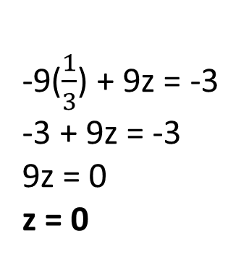
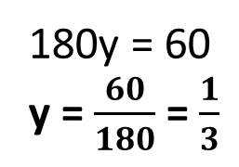
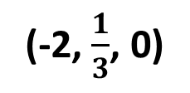
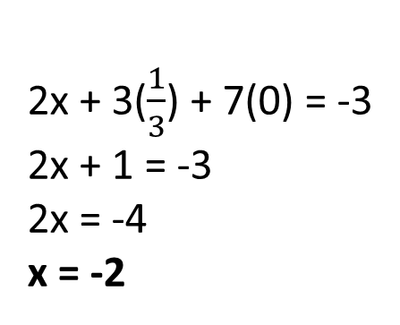
Ex 2
Step 1:
1
2x + 3y + 7z = -3
2x + 3y + 7z = -3
2x + 3y + 7z = -3
x – 6y + z = -4
x – 6y + z = -4
2
-2( )
-2x + 12y – 2z = 8
3
-x – 3y + 8z = 1
4
15y + 5z = 5
Step 2:
Step 3:
x – 6y + z = -4
9( )
2
4
15y + 5z = 5
135y + 45z + 45
-x – 3y + 8z = 1
-9y + 9z = -3
45y – 45z = 15
3
5
-5( )
5
-9y + 9z = -3
180y = 60
y = $\frac{60}{180}$ = $\frac{1}{3}$
Step 5:
Step 4:
2x + 3($\frac{1}{3}$) + 7(0) = -3
2x + 1 = -3
2x = -4
x = -2
-9y + 9z = -3
1
2x + 3y + 7z = -3
5
-9($\frac{1}{3}$) + 9z = -3
-3 + 9z = -3
9z = 0
z = 0
(-2, $\frac{1}{3}$, 0)

Slide 6
Now Try
5x + 2y – z = -7 2) x – 2y – 3z = -1
x – 2y + 2z = 0 2x + y + z = 6
3y + z = 17 x + 3y – 2z = 13
3) x + y + z = 6
2x – y + z = 3
3x – z = 0

Slide 7
Solving a System With No Solutions
*If at any point you get a false statement
(ex: 0=8), there are no solutions

Slide 8
Solving a System with Many Solutions
1
x + y + z = 2
1
x + y + z = 2
x + y – z = 2
2
2
x + y – z = 2
2
x + y – z = 2
2x + 2y + z = 4
3
3
2x + 2y + z = 4
4
2x + 2y = 4
5
3x + 3y = 6
3( )
6x + 6y = 12
4
2x + 2y = 4
This means we have many
solutions
-2( )
-6x – 6y = -12
5
3x + 3y = 6
0 = 0
*Take either equation or and solve for a variable
4
5
2y = 4 – 2x
y = 2 - x
4
2x + 2y = 4
*Take isolated variable and plug into one of the
original equations
x + (2 – x) + z = 2
2 + z = 2
z = 0
1
x + y + z = 2
(x, 2 – x, 0)

Slide 9
Now Try
x – 2y + z = -6
2x – 3y = -7
-x + 3y – 3z = 11

Slide 10
Real Life Application
In yesterday’s swim meet, Roosevelt High dominated in the individual events, with 24 individual-event placers scoring a total of 56 points. A first place finish scores 5 points, second place scores 3 points, and third place scores one point. Having as many third place finishers as first and second place combined really shows the teams depth. Find the number of first, second, and third place finishers.

Slide 11
Real Life Application Continued
x: 1st place finishers
y: 2nd place finishers
z: 3rd place finishers
Total Placers:
Total Points:
Third placers:
1
x + y + z = 24
2
5x + 3y + z = 56
3
x + y = z
x + y + z = 24
2x + 2y = 24
1
x + y + (x + y) = 24
2x + 2y = 24
4
2x + 2(8) = 24
2x + 16 = 24
2x = 8
x = 4
3
x + y = z
4
2
5x + 3y + z = 56
5x + 3y + (x + y) = 56
6x + 4y = 56
x + y = z
5
3
(4) + (8) = z
12 = z
3
x + y = z
2x + 2y = 24
4
-3( )
-6x – 6y = -72
5
6x + 4y = 56
6x + 4y = 56
-2y = -16
y = 8
(4, 8, 12)

Slide 12
Now Try
A theater group sold a total of 440 tickets for $3,940. Each regular ticket costs $5, each premium ticket costs $15, and each elite ticket costs $25. The number of regular tickets was three times the number of premium and elite tickets combined. How many of each type of ticket were sold.

