Slide 1
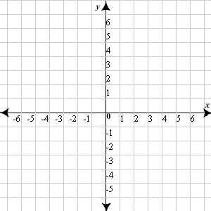
Opening Questions
Graph the functions on the same graph. Find where the graphs intersect. Take these intersection points and plug into the equation C = 6x + 4y. Which intersection will give you the largest value of C? Which will give you the smallest value?
y > -2
2x + 3y < 6
y < 2x + 4

Slide 2
3.4: Linear Programming
Objective: Solve linear programming problems
Use linear programming to solve real
life problems

Slide 3
Vocab
Optimization – finding the maximum or minimum value of some quantity
Linear Programming – the process of optimizing a linear objective function
Constraints – A system (bunch) of linear inequalities
Feasible Region – The graph of a system (bunch) of constraints

Slide 4
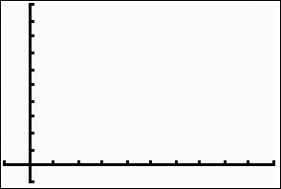
* If an objective function has a maximum or minimum value, then it must occur at a vertex of the feasible region
*The objective function will have both a maximum and minimum if the feasible region is bounded (closed)
Bounded
Unbounded

Slide 5
Solving a Linear Programming Problem
*Graph the constraints (inequality functions)
*Locate vertices of the feasible region (where
graphs intersect)
*Plug vertices into objective function. Which
ever gives you the largest value is the max.
Which ever gives you the smallest value is the
min

Slide 6
Ex
Find the min and max of C = 3x + 4y given the following constraints:
x > 0
y > 0
x + y < 8
(0,8)
y < -x + 8
(0,0)
(8,0)
(0,8): C = 3(0) + 4(8)
= 32
(8,0): C = 3(8) + 4(0)
= 24
(0,0): C = 3(0) + 4(0)
= 0
Max at (0,8), Min at (0,0)

Slide 7
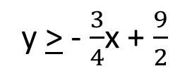
Ex 2
Find the min and max of C = 5x + 6y given the constraints:
x > 0 x + y > 5
y > 0 3x + 4y > 18
y > -x + 5
y > - $\frac{3}{4}$x + $\frac{9}{2}$
(0,5): C = 5(0) + 6(5)
= 30
(0,5)
(2,3): C = 5(2) + 6(3)
= 28
(2,3)
(6,0): C = 5(6) + 6(0)
= 30
Min @ (2,3)
*No max because region is
unbounded and overlap is going
away from the origin in a positive
direction
(6,0)

Slide 8
Now Try
Find the min and max given the objective function and constraints
C = 3x + 2y
3x + 4y < 20
3x – y < 5
x > 0
y > 0

Slide 9
Now Try Continued
C = 2x + 5y
3x – 5y > 24
x – y > 6
x > 0
y < 0

Slide 10
Real World Application
Two manufacturing plants make the same kind of bicycle. The table gives the house of general labor, machine time, and technical labor required to make one bicycle in each plant. For the two plants combined, the manufacturer can afford to use up to 4,000 hours of general labor, up to 1,500 hours of machine time, and up to 2,300 hours of technical labor per week. Plant A earns a profit of $60 per bike and Plant B earns a profit of $50 per bike. How many bicycles per week should the manufacturer make in each plant to maximize profit?
Resource | Hours per bike in Plant A | Hours per bike in Plant B
General Labor | 10 | 1
Machine Time | 1 | 3
Technical Labor | 5 | 2

Slide 11
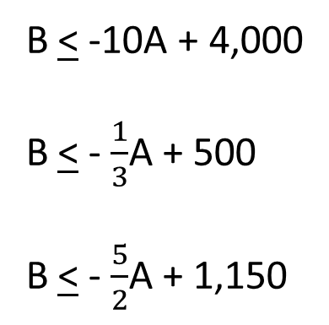
Real World Application Continued
Resource | Hours per bike in Plant A | Hours per bike in Plant B
General Labor | 10 | 1
Machine Time | 1 | 3
Technical Labor | 5 | 2
*First, create the objective function:
What are we trying to optimize?
Profit
P = 60A + 50B
*Next, identify the constraints:
General Labor:
Machine Time:
Technical Labor:
Cannot be negative:
Cannot be negative:
10A + B < 4,000
A + 3B < 1,500
5A + 2B < 2,300
A > 0
B > 0
B < -10A + 4,000
B < - $\frac{1}{3}$A + 500
B < - $\frac{5}{2}$A + 1,150

Slide 12
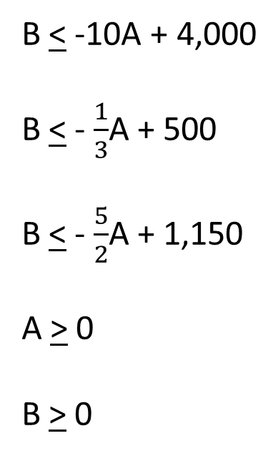
Real World Application Continued
B < -10A + 4,000
B < - $\frac{1}{3}$A + 500
B < - $\frac{5}{2}$A + 1,150
A > 0
B > 0
(0, 500)
(300, 400)
(380, 200)
P = 60A + 50B
(400, 0)
(0, 500): P = 60(0) + 50(500) = 25,000
(300,400): P = 60(300) + 50(400) = 38,000
(380, 200): P = 60(380) + 50(200) = 32,800
(400, 0): P = 60(400) + 50(0) = 24,000
Max
Plant A must make 300 bikes and Plant B must make 400.
This will give them a profit of $38,000

Slide 13
Now Try
A furniture manufacturer makes chairs and sofas from prepackaged parts. The table gives the number of packages of wood parts, stuffing, and material required for each chair or sofa. The packages are delivered weekly and the manufacturer has room to store 1,300 packages of wood parts, 2,000 packages of stuffing, and 800 packages of fabric. The manufacturer earns $200 per chair and $350 per sofa. How many chairs and sofas should they make each week to maximize profits?
Material | Chair | Sofa
Wood | 2 boxes | 3 boxes
Stuffing | 4 boxes | 3 boxes
Fabric | 1 box | 2 boxes

