Slide 1
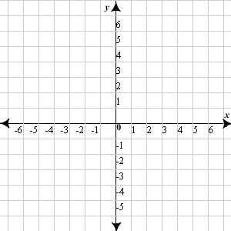
Opening Questions
Graph all the inequalities on the same coordinate plane. Find a solution that statisfies all equations.
1) y > 1 2) x < 6 3) -6y+3x>-6

Slide 2
3.3: Graphing and Solving Systems of Linear Inequalities
Objective: Graph a system of linear inequalities to find the solutions of the system.
Use systems of linear inequalities to solve real life problems.

Slide 3
*To solve a system of linear inequalities, graph each equation. We’re looking for where the overlap is occurring
Ex
y > -3x – 1
y < x + 2

Slide 4
Ex 2
x > 0
4x – 2y < 2
y < 2x + 3
y > 2x - 1

Slide 5
Now Try
1) 3x + y < 5
y > 1
x < 1
2) x + 2y < 6
x – y < 3
x > 0

Slide 6
Now Try Continued
x + y > 2
y < 2
x > 2

Slide 7
Real World Application
A person’s theoretical max heart rate is 220 – x where x is the person’s age in years (20 < x < 65). When a person exercises, it is recommended that the person strive for a heart rate that is at least 70% of their max heart rate and at most 85% of their max heart rate.
You are making a poster for health class. Write and graph a system of linear inequalities that describes the information
x > 20
x < 65
y > .7(220 – x)
y < .85(220 – x)
y > 154 - .7x
y < 187 - .85x

Slide 8
Real World Application Continued
x > 20
x < 65
y > .7(220 – x)
y < .85(220 – x)
y > 154 - .7x
y < 187 - .85x
200
190
180
170
160
150
140
130
120
110
Heart
Rate
10 20 30 40 50 60 70
Age

Slide 9
Now Try
An arena contains 1,200 seats. For an upcoming event, tickets will be priced $12 for some seats and $10 for other seats. At least 500 tickets must be sold at $10 and the total sales must be at least $7,200 to make a profit. What are the possible ways to price the tickets?
1400
1200
1000
800
600
400
200
$12 tickets
200 400 600 800 1000 1200 1400
$10 tickets

