Slide 1
Opening Questions
Solve each equation for the indicated variable
2x – y = 5; y 2) -x + 2y = 3; x
3) 3x – 4y = 12; y 4) 3x – 4y = 12; x

Slide 2
3.2: Solving Linear Systems Algebraically
Objective: Use algebraic methods to
solve linear systems
Use linear systems to model real life situations

Slide 3
* When solving a linear system, you will be given two equations. You have to find values for two variables that will make both equations true
Ex
x + 3y = 5
2x – 3y = 1
x = 2
y = 1
These two solutions work in both
equations
x + 3y = 5
(2) + 3(1) = 5
2 + 3 = 5
5 = 5
2x – 3y = 1
2(2) – 3(1) = 1
4 – 3 = 1
1 = 1

Slide 4
Substitution Method
Solve one of the equations for one of its variables
Substitute the expression from step 1 into the other equation and solve for the other variable
Substitute the value from step 2 into the revised equation from step 1

Slide 5
Ex
*Step 1: solve for a variable
1
3x + 4y = -4
x + 2y = 2
x = 2 – 2y
2
*Step 2: Plug isolated variable into other
equation
*Step 3: Take answer and plug into
revised equation from step 1
x = 2 – 2y
x = 2 – 2(5)
x = 2 – 10
x = -8
3(2 – 2y) + 4y = -4
6 – 6y + 4y = -4
6 – 2y = -4
-2y = -10
y = 5
1

Slide 6
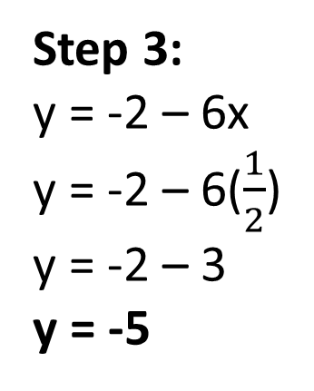
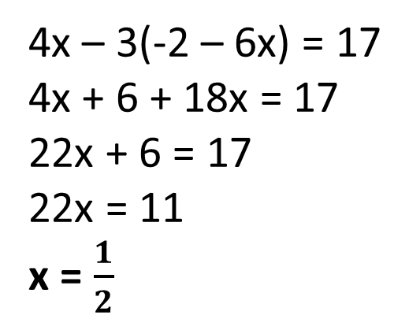
Ex 2
Step 1:
6x + y = -2
4x – 3y = 17
1
y = -2 – 6x
Step 2:
2
4x – 3(-2 – 6x) = 17
4x + 6 + 18x = 17
22x + 6 = 17
22x = 11
x = $\frac{1}{2}$
Step 3:
y = -2 – 6x
y = -2 – 6($\frac{1}{2}$)
y = -2 – 3
y = -5

Slide 7
Now Try
2x – y = 6 2) 6x + 2y = 11
2x + 2y = -9 y = -4x + 6
-7x + 2y = -1
-8x + 4y = -8

Slide 8
Linear Combination Method
Align like terms in columns
Multiply one or both equations by a constant to obtain opposite coefficients
Add the two equations together. One of the variables will cancel. Solve for the remaining variable
Take the solution from step 3 and plug it in either equation. Solve for the remaining variable

Slide 9
Ex
Step 1: Arrange like terms in columns
2
-5x + 5y = 15
1
2x + 3y = -1
5y – 5x = 15
Step 2: Multiply one or both equations
to get opposite coefficients
2
5( )
2( )
2x + 3y = -1
-5x + 5y = 15
10x + 15y = -5
-10x + 10y = 30
Step 3: Add the two equations
together and solve
Step 4: Take answer from step 3
and plug into either equation
10x + 15y = -5
-10x + 10y = 30
0x + 25y = 25
25y = 25
y = 1
2x + 3(1) = -1
2x + 3 = -1
2x = -4
x = -2

Slide 10
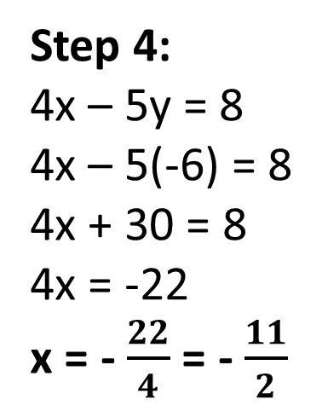
Ex 2
Step 1: Done
Step 2:
2x – 4y = 13
4x – 5y = 8
2x – 4y = 13
4x – 5y = 8
1
-2( )
-4x + 8y = -26
4x – 5y = 8
2
Step 3:
Step 4:
4x – 5y = 8
4x – 5(-6) = 8
4x + 30 = 8
4x = -22
x = - $\frac{22}{4}$ = - $\frac{11}{2}$
-4x + 8y = -26
4x – 5y = 8
2
0x + 3y = -18
3y = -18
y = -6

Slide 11
Now Try
4x + 5y = 13 2) 6y + 11x = 1
3x + y = -4 3x + 2y = -3
3x + 4y = -6 4) 6x – 3y = -3
2x – 5y = 19 -4y + 8x = -4

Slide 12
Special Equations
* Sometimes there is no x and y that will work
for both equations
* When we use the linear combination method
for these equations, both variables end up
canceling out and leave you with an untrue
statement
Ex
2x – 3y = 5
-6x + 9y = 12
* When this happens,
we say there are no
solutions. The graphs
of these equations are
parallel, which is why
there are no solutions
3( )
6x – 9y = 15
-6x + 9y = 12
0x + 0y = 27
0 = 27

Slide 13
*Sometimes no matter what we plug into x and
y, both equations will be true
*When using the linear combination method for
these equations, both variables will cancel and
leave you with a true statement
Ex
2x + 5y = 1
x + $\frac{5}{2}$y = $\frac{1}{2}$
*When this happens, we
say there are infinitely
many solutions. The
graphs of these equations
are coinciding (lying on top
of each other).
2x + 5y = 1
-2x – 5y = -1
-2( )
0x + 0y = 0
0 = 0

Slide 14
Real World Application
A caterer is planning a party for 64 people. The customer has $150 to spend. A $39 pan of pasta feeds 14 people and a $12 sandwich tray feeds 6 people. How many pans of pasta and trays of sandwiches should the caterer make?
*Come up with two equations that represent the different scenarios
P: pasta
S: sandwich
Money Scenario:
39P + 12S = 150
People Scenario:
14P + 6S = 64
39P + 12S = 150
14P + 6S = 64
39P + 12S = 150
-28P + -12S = -128
-2( )
11P = 22
P = 2
14P + 6S = 64
14(2) + 6S = 64
28 + 6S = 64
6S = 36
S = 6
The caterer should make 2 pans of pasta
and 6 trays of sandwiches

Slide 15
Now Try
The band boosters are organizing a trip to a national competition for the 226 member marching band. A bus will hold 70 students. A van will hold 8 students. The bus costs $280 to rent for the trip while the van costs $70. The boosters have $980 to use for the transportation. How many buses and vans should they rent?

Slide 16
Homework:
Pg 152 #’s 11 – 48 Even

