Slide 1
Opening Questions
Evaluate the expression for x = -6
|x| 2) -|x – 3| 3) -3|x + 4| - 1
Solve for x
|-3x| 5) |-4 + 5x| = 16 6) |v + 8|- 5 = 16
7) |2x| = -6

Slide 2
2.8: Absolute Value Functions
Objective: Represent absolute value functions

Slide 3
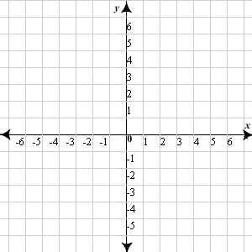
Representing Absolute Value Functions
*Absolute value can be represented as a piecewise function
f(x) = $\left\{\begin{aligned}x; x>0 \\ 0; x=0 \\ −x; x<0\end{aligned}\right.$
*A graph of this piecewise looks like this:
*Notice there is symmetry
along x = 0

Slide 4
What if we were to manipulate an absolute value equation?
- Let’s say we have f(x) = |2x|. What would this graph look like?
f(1) = |2(1)|
f(1) = |2|
f(1) = 2
f(-1) = |2(-1)|
f(-1) = |-2|
f(-1) = 2
f(2) = |2(2)|
f(2) = |4|
f(2) = 4
f(-2) = |2(-2)|
f(-2) = |-4|
f(-2) = 4

Slide 5
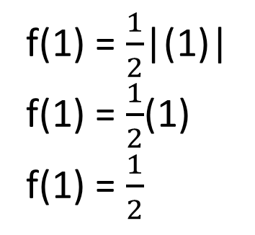



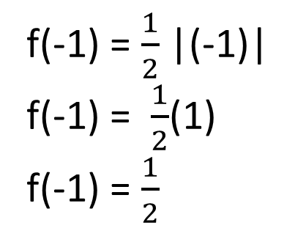
f(0) = $\frac{1}{2}$|0|
f(0) = 0
What about f(x) = ½|x|?
f(1) = $\frac{1}{2}$|(1)|
f(1) = $\frac{1}{2}$(1)
f(1) = $\frac{1}{2}$
f(-1) = $\frac{1}{2}$|(-1)|
f(-1) = $\frac{1}{2}$(1)
f(-1) = $\frac{1}{2}$
f(2) = $\frac{1}{2}$|(2)|
f(2) = $\frac{1}{2}$(2)
f(2) = 1
f(-2) = $\frac{1}{2}$|(-2)|
f(-2) = $\frac{1}{2}$(2)
f(-2) = 1

Slide 6
f(x) = -|x|
f(0) = -|0|
f(0) = 0
f(1) = -|1|
f(1) = -1
f(-1) = -|-1|
f(-1) = -1
f(2) = -|2|
f(2) = -2
f(-2) = -|-2|
f(-2) = -2

Slide 7
f(x) = |x – 2|
f(2) = |(2) – 2|
f(2) = |0|
f(2) = 0
f(3) = |(3) – 2|
f(3) = |1|
f(3) = 1
f(1) = |(1) – 2|
f(1) = |-1|
f(1) = 1
f(4) = |(4) – 2|
f(4) = |2|
f(4) = 2
f(0) = |(0) – 2|
f(0) = |-2|
f(0) = 2

Slide 8
f(x) = |x + 1|
f(-1) = |(-1) + 1|
f(-1) = |0|
f(-1) = 0
f(0) = |(0)+1|
f(0) = |1|
f(0) = 1
f(-2) = |(-2)+1|
f(-2) = |-1|
f(-2) = 1
f(1) = |(1)+1|
f(2) = |2|
f(2) = 2
f(-3) = |(-3)+1|
f(-3) = |-2|
f(-3) = 2

Slide 9
f(x) = |x| - 2
f(0) = |0| - 2
f(0) = -2
f(1) = |1| - 2
f(1) = 1 – 2
f(1) = -1
f(-1) = |-1| - 2
f(-1) = 1 – 2
f(-1) = -1
f(2) = |2| - 2
f(2) = 2 – 2
f(2) = 0
f(-2) = |-2| - 2
f(-2) = 2 - 2
f(-2) = 0

Slide 10
f(x) = |x| +2
f(0) = |0| + 2
f(0) = 2
f(1) = |1| + 2
f(1) = 1 + 2
f(1) = 3
f(-1) = |-1| + 2
f(-1) = 1 + 2
f(-1) = 3
f(2) = |2| + 2
f(2) = 2 + 2
f(2) = 4
f(-2) = |-2| + 2
f(-2) = 2 + 2
f(-2) = 4

Slide 11
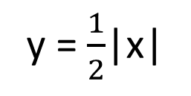
Let’s Recap
y = |x|
y = 2|x|
y = $\frac{1}{2}$|x|
y = -|x|
y = |x – 2|
y = |x + 1|
y = |x| – 2
y = |x| + 2

Slide 12
Graphing Absolute Value Functions
y = a|x – h| + k
The graph has a vertex (h,k) and is symmetric at the line x = h
The graph is V shaped. It opens up if a > 0 and down if a < 0
The graph is wider than the graph y = |x| if |a|<1
The graph is narrower than the graph y = |x| if |a|>1

Slide 13
Ex
Graph y = -|x + 2| + 3
*Vertex @ (-2,3)
*Opens downward
*Slope of each line is 1, -1

Slide 14
Ex 2
y = 3|x-2|- 4
*Vertex @ (2,-4)
*Opens upward
*Slope of each line is 3, -3

Slide 15

Now Try
1) y = -2|x + 1| + 3 2) y = |x| + 5 3) y = - $\frac{1}{3}$|x – 1| - 3

Slide 16
Writing Absolute Value Functions
y = a|x – h| + k
h
k
Find the vertex: (0,-3)
*Solve for “a”
-choose a point on the graph
(-1,-1):
-1 = a|-1 – 0| + (-3)
-1 = a|-1| - 3
-1 = a – 3
2 = a
Equation: y = 2|x – 0| - 3 or y = 2|x| - 3

Slide 17
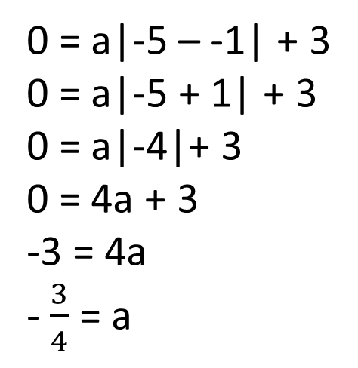
Ex 2
y = a|x – h| + k
h
k
Find the vertex: (-1,3)
*Solve for “a”
-choose a point on the graph
(-5,0):
0 = a|-5 – -1| + 3
0 = a|-5 + 1| + 3
0 = a|-4|+ 3
0 = 4a + 3
-3 = 4a
- $\frac{3}{4}$ = a
Equation: y = - $\frac{3}{4}$|x + 1| + 3

Slide 18
Now Try
1)
2)
3)

Slide 19
Homework
Pg 125 #’s 4-38 Even, don’t do #’s 26 – 32

