Slide 1
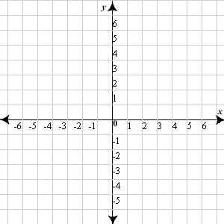
Opening Questions
Evaluate the function for the indicated values: f(x) = 3x – 2
1) f(2) 2) f(0) 3) f(-2)
Graph the two linear equations on the same
coordinate plane
y = -x – 4
y = 2x + 1

Slide 2
2.7: Piecewise Functions
Objective: Represent piecewise functions
Use piecewise functions to model real life quantities

Slide 3
* So far, our functions have been represented by one equation
*However, many real life problems are represented by a combination of equations, each corresponding to part of a domain
* These functions are called piecewise functions
Ex
f(x) = $\left\{\begin{aligned}2x −1, if x≤1 \\ 3x+1, if x>1\end{aligned}\right.$
*This means for all x-values less than or
equal to 1, the function is represented
with the equation 2x – 1
*For all x-values greater than 1, the
function is represented with the
equation 3x + 1

Slide 4

Evaluating Piecewise Functions
Ex
f(x) = $\left\{\begin{aligned}x+2; x<2 \\ 3x+1; x ≥2\end{aligned}\right.$
Evaluate:
f(0)
*Because 0 is less than 2,
use the equation x + 2
f(0) = (0) + 2
f(0) = 2
f(2)
*Because 2 is equal to 2,
Use the equation 3x + 1
f(2) = 3(2) + 1
f(2) = 7
c) f(4)
*Because 4 is greater than 2,
Use the equation 3x + 1
f(4) = 3(4) + 1
f(4) = 13

Slide 5

Now Try:
f(x) = $\left\{\begin{aligned}x+1; x>1 \\ −x −2; x ≤1\end{aligned}\right.$ g(x) = $\left\{\begin{aligned}3x+2; x<5 \\ −2x; x ≥5\end{aligned}\right.$
Evaluate:
1) g(5) 2) f(0) 3) f(3) 4) g(-2)

Slide 6

Graphing a Piecewise Function
* Look at the first portion of the piecewise.
The graph will be $\frac{1}{2}x+ \frac{3}{2}$ for all values x<1
Ex
f(x) = $\left\{\begin{aligned}\frac{1}{2}x+ \frac{3}{2}; x<1 \\ −x+3; x ≥1\end{aligned}\right.$
* Graph the other portion. The graph will be
-x + 3 for all value x > 1

Slide 7

Ex 2
f(x) = $\left\{\begin{aligned}−x; x ≤3 \\ \frac{2}{3}x−4; x>3\end{aligned}\right.$
* Open circle in the second
graph because it does not
include 3
* Closed circle in the first
graph because it includes
3

Slide 8

Now Try:
2) f(x) = $\left\{\begin{aligned}\frac{1}{2}x+4; x<2 \\ −2x+9; x ≥2\end{aligned}\right.$
1) f(x) = $\left\{\begin{aligned}x+2; x>1 \\ −x+2; x≤1\end{aligned}\right.$

Slide 9

Now Try Continued:
3) f(x) = $\left\{\begin{aligned}2x; x ≥−1 \\ 3x; −2<x<−1 \\ −x; x ≤−2\end{aligned}\right.$

Slide 10
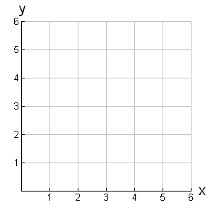
Step Functions
*Step functions resemble steps. They consist of horizontal line segments
Ex
f(x) = $\left\{\begin{aligned}1; 0≤x<1 \\ 2; 1≤x<2 \\ 3; 2≤x<3 \\ 4; 3≤x<4\end{aligned}\right.$

Slide 11
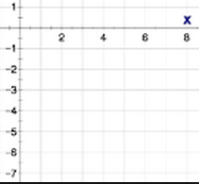

Ex 2
f(x) = $\left\{\begin{aligned}−2; 0≤x<2 \\ −4; 2≤x<4 \\ −6; 4≤x<6\end{aligned}\right.$

Slide 12
Now Try:
f(x) = $\left\{\begin{aligned}1; 0 <x≤1 \\ 3; 1<x≤2 \\ 4; 2<x≤3 \\ 6; 3<x≤4\end{aligned}\right.$

Slide 13


Writing Piecewise Functions
*First, find the intervals
x < 0, x > 0
Ex
* Then, find two points on each
line to find the equation of each line
x < 0: (0,2)
(-2,0)
m: $\frac{2−0}{0 −−2}$ = $\frac{2}{2}$ = 1
Slope-intercept: 2 = 1(0)+b
2 = b
y = x + 2
x > 0: (0,0)
(2,2)
m: $\frac{2−0}{2−0}$ = $\frac{2}{2}$ = 1
Slope-intercept: 0 = 1(0)+b
0 = b
y = x
f(x) = $\left\{\begin{aligned}x+2; x<0 \\ x; x≥0\end{aligned}\right.$

Slide 14
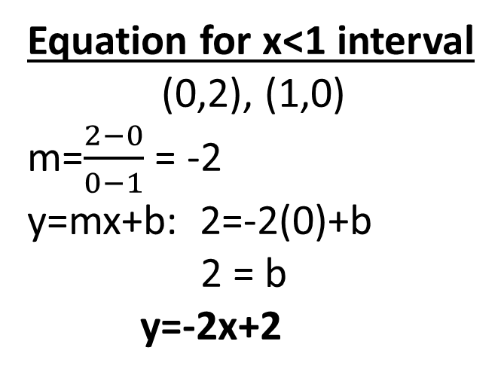
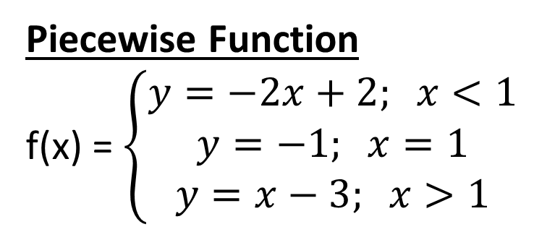
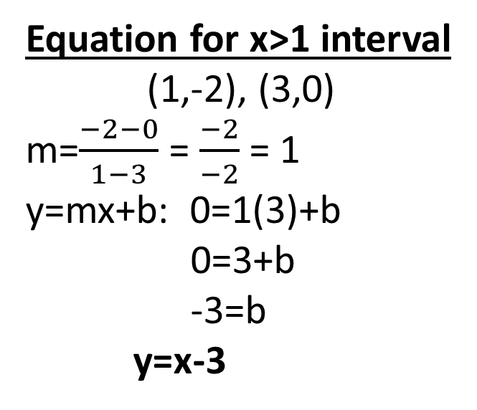
Ex 2
Intervals: x < 1
x = 1
x > 1
Equation for x<1 interval
(0,2), (1,0)
m=$\frac{2−0}{0−1}$ = -2
y=mx+b: 2=-2(0)+b
2 = b
y=-2x+2
Equation for x>1 interval
(1,-2), (3,0)
m=$\frac{−2−0}{1−3}$ = $\frac{−2}{−2}$ = 1
y=mx+b: 0=1(3)+b
0=3+b
-3=b
y=x-3
Piecewise Function
f(x) = $\left\{\begin{aligned}y=−2x+2; x<1 \\ y=−1; x=1 \\ y=x−3; x>1\end{aligned}\right.$

Slide 15
Now Try
1)
2)
3)

Slide 16
Real World Application
You have a summer job that pays time and a half for overtime. You’re paid $7 per hour.
Write a piecewise function to describe your weekly pay
x: number of hours
y: pay
*If x < 40, then you’re paid 7x
*If x > 40, you still get paid for the first 40
hours plus the time and a half pay
7(40) + 7(1.5)(x – 40)
280 + 10.5(x – 40)
280 + 10.5x – 420
10.5x – 140
Pay for first
40 hours
Hours over
40 hours
Time and
a half pay
f(x) = $\left\{\begin{aligned}7x; x≤40 \\ 10.5x−140; x>40\end{aligned}\right.$

Slide 17
Now Try
You own a screen printing shop. You have an initial charge of $20 to create a screen print. For orders of 50 shirts or less, you charge $17 per shirt. For orders over 50, you charge $15.80 per shirt. Write a piecewise function representing the scenario

