Slide 1
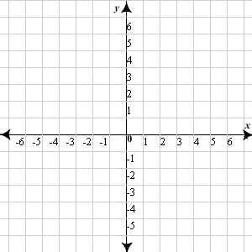
2.6 Opening Questions
Graph each line on the same coordinate plane
1) y = 2 2) x = -1 3) –x + y = 1 4) y = 3x + 1

Slide 2
2.6: Linear Inequalities In Two Variables
Objective: Graph linear inequalities in two variables
Use linear inequalities to solve real life problems

Slide 3
Checking Solutions of Inequalities
> : Greater Than < : Less Than
> : Greater Than or Equal to < : Less Than or Equal to
* An ordered pair, (x,y), is a solution to an equation if when plugged in,
the equation holds true
Ex
Is (0,1) a solution to 2x + 3y > 5?
2(0) + 3(1) > 5
3 > 5 No, (0,1) is not a solution

Slide 4
Now Try
Is the coordinate point a solution to the given equation?
1) -x + 2y < 6; (0,-6) 2) y < x + 1; (4,5)
3) x > -1; (5,2) 4) 2y + x > 3; (1,1)

Slide 5
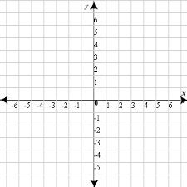
Graphing Linear Inequalities
Ex 1
Graph y < -2
*If < or >, use a dashed line
*If < or >, use a solid line

Slide 6
Ex 2
Graph 2x – 5y < 10
-5y < 10 – 2x
y > -2 + $\frac{2}{5}$ x

Slide 7

Now Try
1) y > -x + 2 2) y < - $\frac{1}{2}$x + 4 3) -3y < 3x + 9

Slide 8
Real World Application
You have relatives living in both the U.S. and Mexico. You are given a tracphone with $50 worth of minutes on it. Calls within the U.S. cost $0.16 per minute and calls to Mexico are $0.44 per minute
a) Write a linear inequality to represent the number of minutes you
can use for calls within the U.S. and Mexico
x: number of minutes for U.S. calls
y: number of minutes for Mexico calls
.16x + .44y < 50
Graph the inequality and give three
different scenarios for answers

Slide 9
Now Try
You earn $3 per hour when you babysit the Thompson children. You earn $3.50 per hour babysitting the Stewart Children. You would like to buy a concert ticket for $47.50 with your babysitting money.
Write a linear inequality representing the given scenario
b) Graph the given scenario and give a few possible answers.

Slide 10
Homework
Pg. 111, #’s 2-34 even, 46, 47

