Slide 1
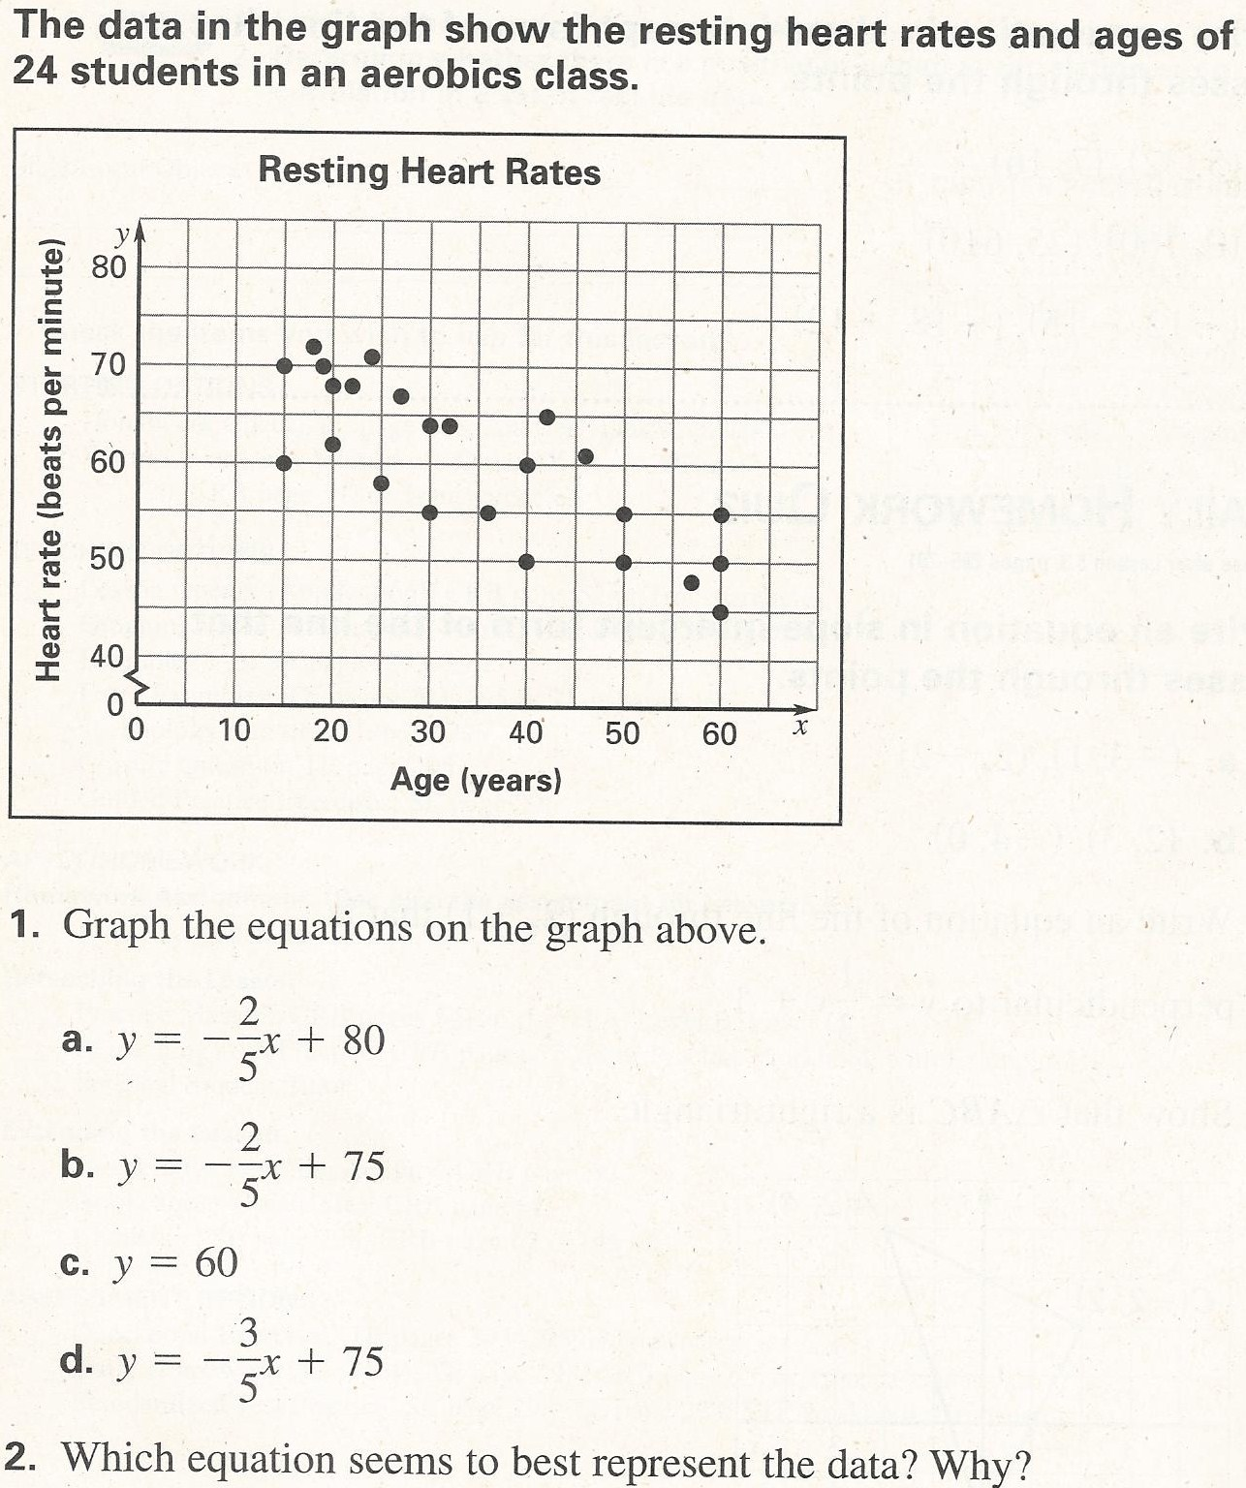
2.5 Opening Questions

Slide 2
2.5: Correlation and Best Fitting Lines
Objective: Use a scatter plot to identify the correlation shown by a set of data
Approximate the best fitting line for a set of data

Slide 3
Vocab
Scatter Plot: a graph used to determine whether there is a relationship between paired data. The points do not have to lie on a perfect line
Positive Correlation: as “x” tends to increase, so does “y”
Negative Correlation: as “x” tends to increase, “y” decreases
Relatively No Correlation: there is no linear pattern

Slide 4
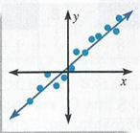
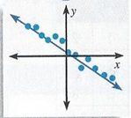
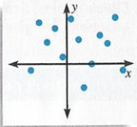
Positive
Correlation
Negative
Correlation
Relatively No
Correlation

Slide 5
Creating a Line of Best Fit And It’s Equation
Step 1: Draw a scatter plot of the data
Step 2: Sketch the line that appears to follow most closely the pattern of the points. There should be as many points above the line as below
Step 3: Choose two points on the Line of Best Fit. These points do not have to be original data points
Step 4: Find the equation of the line going through these two points

Slide 6
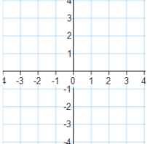
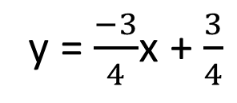
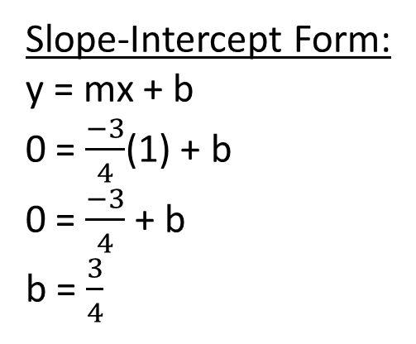
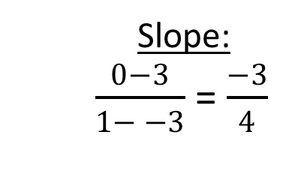
Ex
Create a line of best fit and find the equation that best describes the data. With that equation, predict what “y” will be if x = 5
Two Coordinate Points:
(-3,3) and (1,0)
Slope:
$\frac{0−3}{1− −3}$ = $\frac{−3}{4}$
Slope-Intercept Form:
y = mx + b
0 = $\frac{−3}{4}$(1) + b
0 = $\frac{−3}{4}$ + b
b = $\frac{3}{4}$
y = $\frac{−3}{4}$x + $\frac{3}{4}$

Slide 7
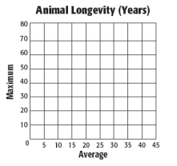
Now Try
Draw a scatter plot and determine, what
relationship, if any, exists in the data
Draw a line of fit for the scatter plot and write
the slope-intercept form of an equation for
the line of fit
Predict the maximum longevity for an animal
with an average longevity of 33 years.

Slide 8
Homework
Correlation and Best Fitting Lines Worksheet

