Slide 1
2.3 Opening Questions Graph the equation going through (-5,9) and (-4,7) 1. What is the slope going through these points? 2. What is the y-intercept? 3. Knowing the slope and y-intercept, what is the equation of the line?

Slide 2
2.4: Writing Equations of Lines
Objective: Write linear equations
Write direct variation equations

Slide 3
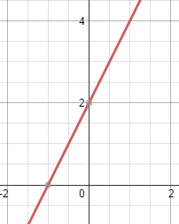
Slope-Intercept Form
y = mx + b
Writing an Equation Given the Graph
Write the equation of the line shown
slope
y-intercept
y = 2x + 2

Slide 4
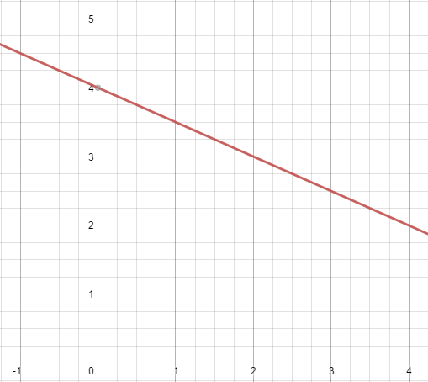
Now Try:
Write the equation of the line shown

Slide 5
Point-Slope Form
slope
Ex
Write the equation of the line with a slope of -2
and goes through the point (1,2)
y – $y_{1}$ = m(x - $x_{1}$)
y-coordinate
x-coordinate
y – 2 = -2(x – 1)
Converting to slope-intercept form:
y – 2 = -2x + 2
y = -2x + 4
* Using slope-intercept form:
y = mx + b
2 = -2(1) + b
2 = -2 + b
4 = b
y = -2x + 4

Slide 6
Ex 2
Write the equation of the line with a slope of -1 and goes through the point (8,-2) in point-slope and slope-intercept forms
Point-Slope: Slope-Intercept Form:
y + 2 = -1(x – 8) -2 = -1(8) + b
-2 = -8 + b
6 = b
y = -x + 6

Slide 7
Now Try:
Write the equation of each line with the given slopes going through the given points. Write the equations in point-slope and slope-intercept form.
1. m = -$\frac{1}{2}$, (2,3) 2. m = 0, (-3, -2)

Slide 8


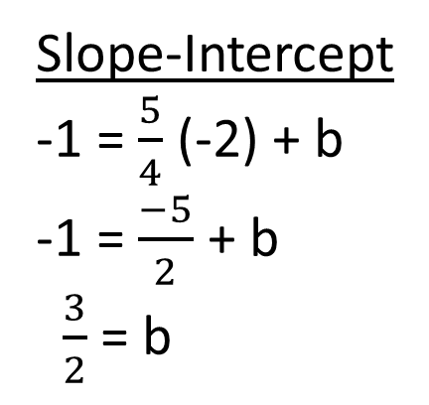
Writing an Equation Given Two Points
Write the equation of the line going through (-2,-1) and (2,4)
Find “m” First
$\frac{4 −−1}{2−−2}$ = $\frac{5}{4}$
Point-Slope
y + 1 = $\frac{5}{4}$(x + 2)
Slope-Intercept
-1 = $\frac{5}{4}$ (-2) + b
-1 = $\frac{−5}{2}$ + b
$\frac{3}{2}$ = b
y = $\frac{5}{4}$x + $\frac{3}{2}$

Slide 9
Now Try:
Write the equation of each line going through the given points in point-slope and slope-intercept form
1. (2,5)(4,-1) 2. (-2,1)(4,7)

Slide 10
Writing Equations of Line That Are Parallel and Perpendicular
*Remember, when lines are parallel, slopes are equal. When lines are
perpendicular, slopes are opposite reciprocals.
Ex
Write the equations of the lines that pass through (1,1) and are
a) parallel and b) perpendicular to y = $\frac{1}{2}$x - 7
Parallel
y = $\frac{1}{2}$x + b
1 = $\frac{1}{2}$ (1) + b
1 = $\frac{1}{2}$ + b
$\frac{1}{2}$ = b
Perpendicular
y = -2x + b
1 = -2(1) + b
1 = -2 + b
3 = b
y = -2x + 3
y = $\frac{1}{2}x$ + $\frac{1}{2}$

Slide 11
Now Try:
Write the equations of the lines parallel and perpendicular to the line at the given point.
1. y = -4x + 3 going through (-3,2) 2. x = 2 going through (5,2)

Slide 12
Direct Variation
y = kx
* Graph of direct variation goes through the origin
Constant of variation
Ex
Write the equation relating x and y when y = 12 and x = 4
y = kx
12 = k(4)
3 = k
y = 3x

Slide 13
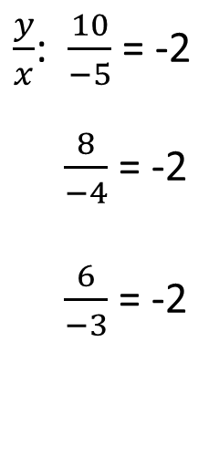
Ex 2
Tell whether the data shows direct variation. If so, write the equation for direct variation
X | -5 | -4 | -3 | -2 | -1
Y | 10 | 8 | 6 | 4 | 2
*Compare inputs with outputs. See if they
are proportional
$\frac{y}{x}$: $\frac{10}{−5}$ = -2
$\frac{8}{−4}$ = -2
$\frac{6}{−3}$ = -2
*What is the constant of variation (k)?
Answer: -2. So y = -2x

Slide 14
Now Try:
Tell whether the data shows direct variation. If so, write the equation
for direct variation
x | 1 | 2 | 3 | 4 | 5
Y | 5 | 4 | 3 | 2 | 1

Slide 15
Real Life Application
From 1840 to 1850, the rate at which the percentage of labor force in nonfarming occupations increased was approximately linear. In 1840, 31.4% of the labor force held nonfarming jobs. In 1850, 36.3% of the labor force held nonfarming jobs.
1. Write a linear model for the percentage of the labor force in nonfarming occupations. Let t = 0 represent 1840.
(0,31.4)(10,36.3)
In 1860, the percentage of labor force in nonfarming occupations was 41.1%. Is this model for the percentage of nonfarming occupations from 1840 to 1850 still appropriate?
y = .49t + 31.4
$\frac{36.3 −31.4}{10−0}$ = $\frac{4.9}{10}$ = .49
y = mx + b
31.4 = .49 (0) + b
31.4 = b
y = .49t + 31.4
y = .49 (20) + 31.4
y = 9.8 + 31.4
y = 41.2; very close to the original
coordinate point, so YES
(20, 41.1):

Slide 16
Now Try:
The rate of increase in tuition at a college from 1990 to 1995 was approximately linear. In 1990, the tuition was $15,500 and in 1995 tuition was $22,600.
Write a linear model for the tuition from 1990 to 1995. Let t = 0 represent 1990.
If this continues, what is the price of tuition this year?

Slide 17
Homework
Pg 95 #’s 14 – 62 even.

