Slide 1
2.3 Opening Questions
During a basketball game, Lisa made 30 points in field goals (a field goal is worth 2 or 3 points)
If Lisa made 9 field goals worth of 2 points each, how many did she make worth 3 points?
Let “x” represent the number of 2 point field goals Lisa made and “y” represent the number of 3 point field goals she made. Write an equation to model the situation
Plot several points to graph the equation
Where does the graph cross the x-axis? What does this point represent in terms of Lisa’s points?
Where does the graph cross the y-axis? What does this point represent in terms of Lisa’s points?

Slide 2
2.3: Quick Graphs of Linear Equations
Objective: Use the slope-intercept form of a linear equation to graph linear equations
Use the standard form of a linear equation to graph linear equations

Slide 3
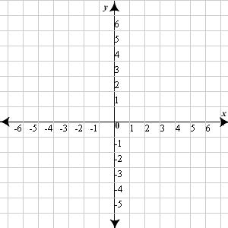

Slope-Intercept Form
y = mx + b
Ex
Graph y = $\frac{3}{4}$x - 2
slope
y-intercept

Slide 4
Standard Form
Ax + By = C
*Use this when graphing by “x” and “y” intercepts
*x-intercept: plug zero in for y
*y-intercept: plug zero in for x
Ex
Graph -2x + 3y = 6
x-intercept: y-intercept:

Slide 5
Now Try:
Graph -2x + 3y = 6

Slide 6
Horizontal and Vertical Lines
Horizontal Line – y = c is a horizontal line through (0,c)
Vertical Line – x = c is a vertical line through (c,0)

Slide 7
Real World Application
A restaurant serves vegetarian and chicken lunch specials each day. Each vegetarian special is the same price. Each chicken special is the same price. However, the price of the vegetarian special is different from the price of the chicken special. On Thursday, the restaurant collected $467, selling 21 vegetarian specials and 40 chicken specials.
Write an equation that represents the cost of each meal
Convert this equation to slope-intercept form of vegetarian specials in terms of chicken specials

Slide 8
Homework
Pg 87, #’s 37 – 60

