Slide 1

2.2 Opening Questions
Evaluate the expressions
1. $\frac{−1 −4}{4 −(−3)}$ 2. $\frac{0−(−2)}{1−(−2)}$ 3. $\frac{3−4}{2+1}$
4. $\frac{2−(−2)}{3−6}$

Slide 2
2.2: Slope and Rate of Change
Objective: Find slopes of lines and classify parallel and perpendicular lines
Use slope to solve real-life problems

Slide 3
Vocab
Slope – the ratio of vertical change (rise) to horizontal change (run); steepness of a line
Also represented by: m, $\frac{rise}{run}$, $\frac{y_{2}− y_{1}}{x_{2}− x_{1}}$, rate of change
*The greater the absolute value of the slope, the greater the pitch

Slide 4
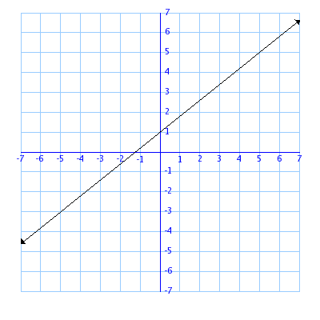
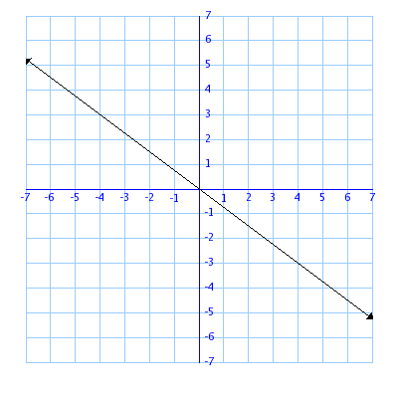
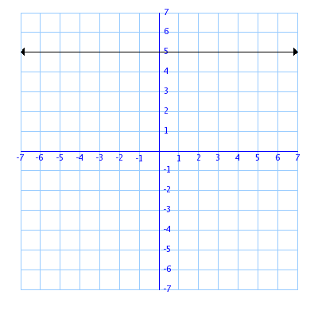
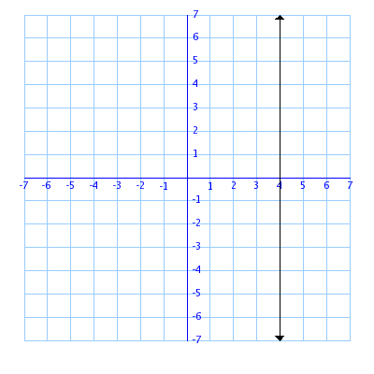
Positive
Slope
Negative
Slope
Zero
Slope
Undefined
Slope

Slide 5
Finding the Slope Given Two Points
Find the slope passing through
(-3,5)(2,1) 2. (-1,4)(-3,4) 3. (4,-1)(4,4)

Slide 6
Now Try
(3,2)(5,4) 2. (2,5)(-7,5) 3. (4,1)(-6,3)
4. (5,-1)(5,6)

Slide 7
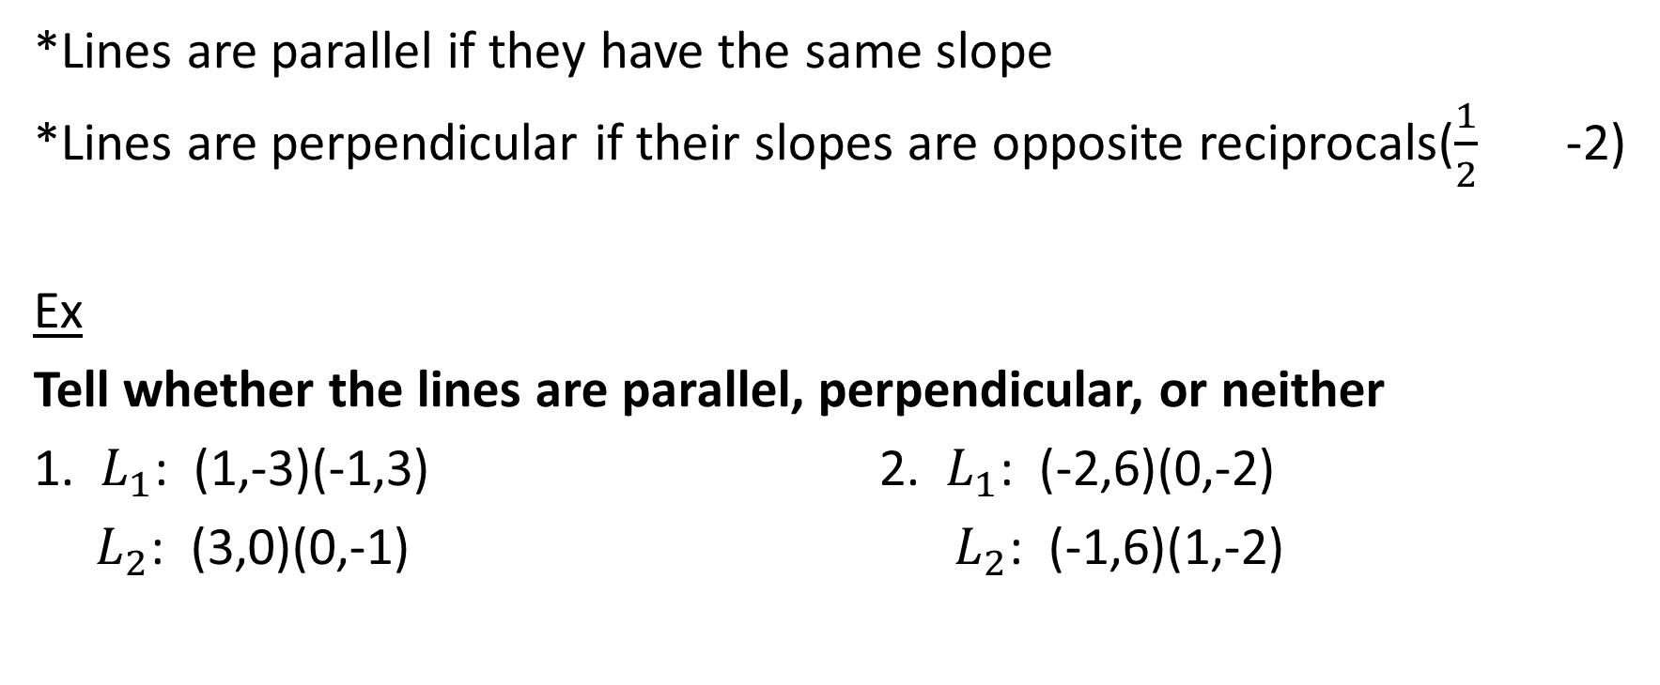
Parallel and Perpendicular Lines
*Lines are parallel if they have the same slope
*Lines are perpendicular if their slopes are opposite reciprocals($\frac{1}{2}$ -2)
Ex
Tell whether the lines are parallel, perpendicular, or neither
1. $L_{1}$: (1,-3)(-1,3) 2. $L_{1}$: (-2,6)(0,-2)
$L_{2}$: (3,0)(0,-1) $L_{2}$: (-1,6)(1,-2)

Slide 8

Now Try
1. $L_{1}$: (2,4)(-1,-5) 2. $L_{1}$: (-3,5)(-6,-1)
$L_{2}$: (0,-2)(-3,-7) $L_{2}$: (-2,-5)(4,-8)

Slide 9
Real Life Application
The average bathtub is 60in x 30in x 15in. A gallon of water is equal to .134 ft³. If you shower, it takes 8 minutes and 10 seconds to fill the tub. It will take 2 minutes and 23 seconds to fill the same tub if you take a bath.
How many gallons will it take to fill the tub?
Find the average rate of change of filling the tub by showering and taking a bath in cubic feet per second

Slide 10
Homework
Pg 79, #’s 17-31, 41-49

