Slide 1
2.1 Opening Questions
Evaluate the expression when x = -2
1. 4x – 2 2. $\frac{1}{3}$x + $\frac{5}{3}$ 3. 2x² – x + 4
4. -4x² – 6x + 12 5. $\frac{1}{2}$ |x-3| - $\frac{3}{2}$

Slide 2
2.1: Functions and Their Graphs Objective: Represent relations and functions Graph and evaluate linear functions

Slide 3
Vocab
Relation – pairing of input values with output values
Domain – input values, x-values, independent variable
Range – output values, y-values, dependent variable
Linear Function – y = mx + b (slope-intercept); forms a line
Function Notation – replacing “y” with “f(x)” in a linear function

Slide 4
Representing Relations and Functions
* For something to be a function, each input must have one output
Ex
Not a Function
Function

Slide 5
Identifying Quadrants
II (-,+) | I (+,+)
III (-,-) | IV (+,-)

Slide 6
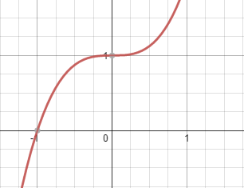
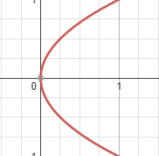
*In order for a graph to be a function, it must pass the vertical line test
Ex
Function
Not a Function

Slide 7
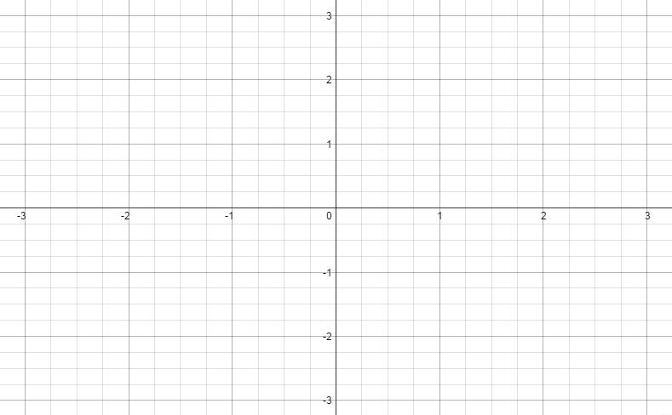
Graphing and Evaluating Functions
Graphing Using a Table
Graph y = - $\frac{1}{2}$x + 1
Independent | -2 | -1 | 0 | 1 | 2
Dependent | 2 | 1.5 | 1 | .5 | 0

Slide 8
Evaluating Functions
Decide whether the function is linear. Then, evaluate for the given value:
f(x) = 3x – 11; f(0) 2. f(x) = x² – 4; f(1)
Yes, f(0) = -11 No, f(1) = -3

Slide 9
Real World Application
The table shows the number of games won and lost by some teams in the NFL.
Team | Won | Lost
Dallas Cowboys | 10 | 6
Philadelphia Eagles | 10 | 6
Washington Redskins | 9 | 7
Arizona Cardinals | 7 | 9
New York Giants | 6 | 10
What is the domain and range?
D: {10,9,7,6}
R: {6,7,9,10}
Is the number of wins a function of
the number of losses?
Yes

Slide 10
Homework
Page 71 #’s 1-18

